Slide 1

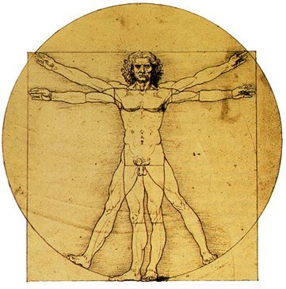
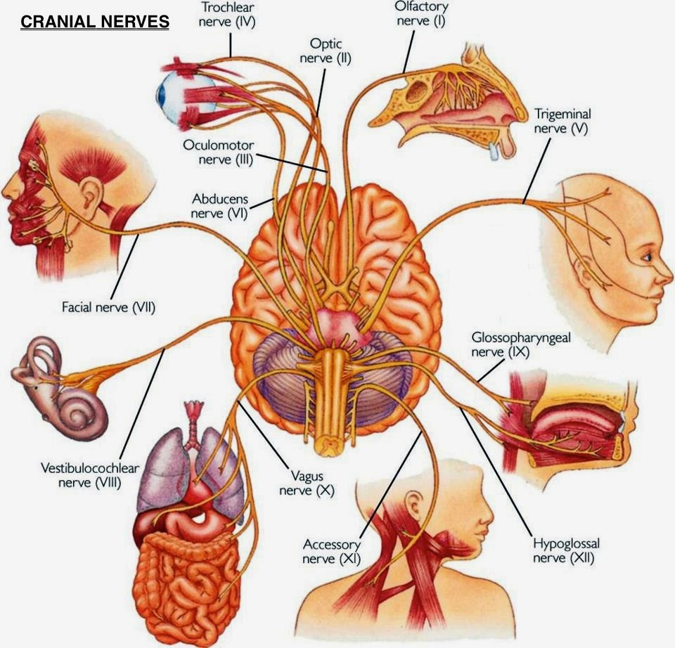
Central Nervous System, Cranial Nerves, Lesions and Their Clinical Significance
Dr Tampaki Ekaterini Christina, Plastic and Reconstructive Surgeon
Dr Filippou Dimitrios, Assistant Professor- General Surgeon

Slide 2
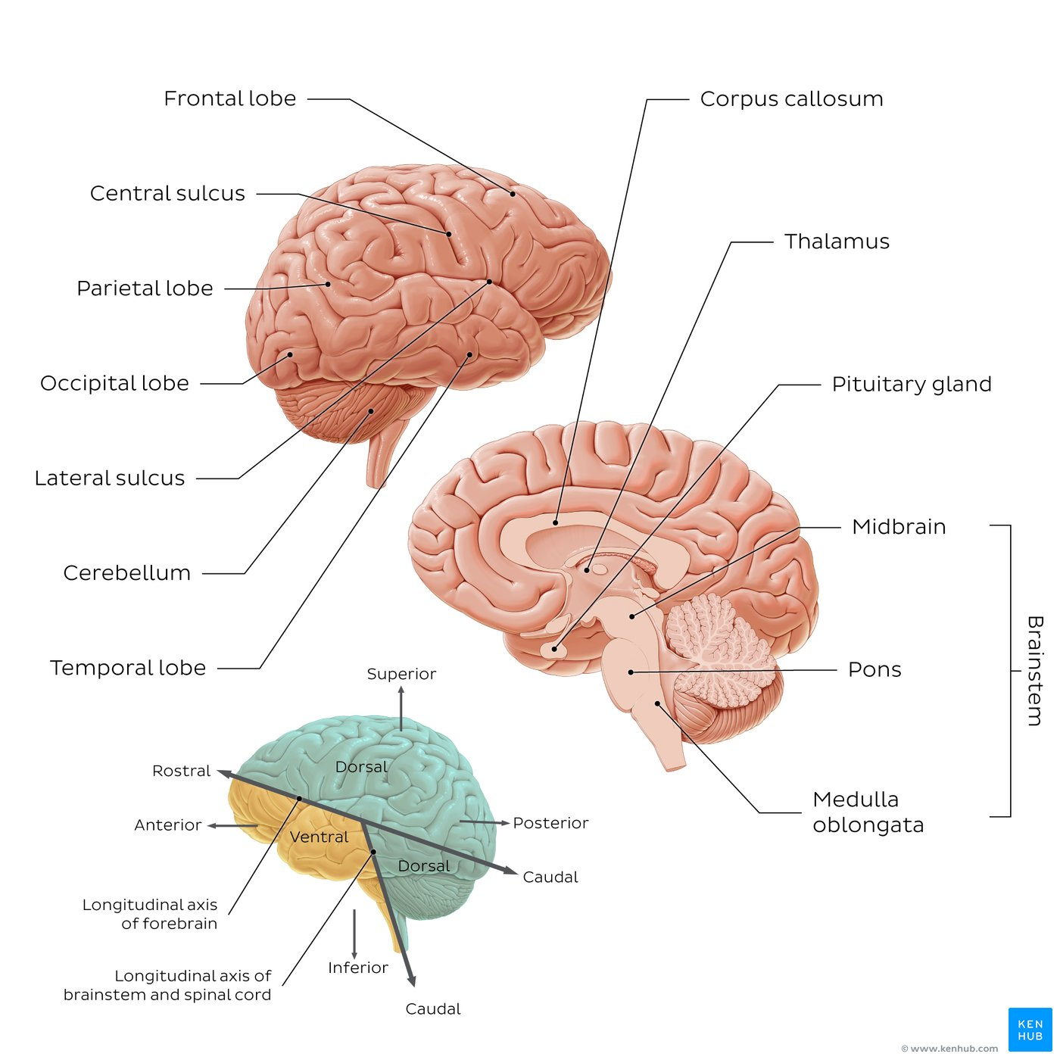
The brain: overview
The brain consists of three main parts; cerebrum, cerebellum and brainstem.
The cerebrum is organized into two hemispheres that are connected by a large bundle of white matter tissue called the corpus callosum. Each hemisphere of the cerebrum contains five lobes: frontal, temporal, parietal, occipital and insular. The insular lobe is not visible in this image as it is covered by the portions of the parietal, temporal and frontal lobes. These portions together are called operculum, which means “covering” of the insula.
The outer surface of the cerebrum exhibits many elevated ridges of tissue called gyri, that are separated by grooves called sulci. The gyri and sulci increase the surface area of the cerebrum, providing it with its characteristic convoluted appearance.
The cerebellum is found inferior to the occipital lobe of the cerebrum. It also has two hemispheres that are connected by the vermis.
The brainstem is the most caudal part of the brain. It is made up of the midbrain, pons, and medulla oblongata, each of which have their own structural and functional organization.

Slide 3
The Brain: Key points
Parts of the brain | Cerebrum, cerebellum, brainstem
Structural components of the parts of the brain | Cerebrum: Frontal, temporal, parietal, occipital and insular lobe Cerebellum: Vermis and hemispheres (anterior, posterior, flocculonodular lobes) Brainstem: Medulla oblongata, pons, midbrain
Basic functions of the parts of the brain | Cerebrum: Higher bodily function (cognition, emotions, learning, voluntary movements) Cerebellum: Motor functions (balance, coordination, speech) Brainstem: Lower bodily functions (breathing, heart rate)

Slide 4
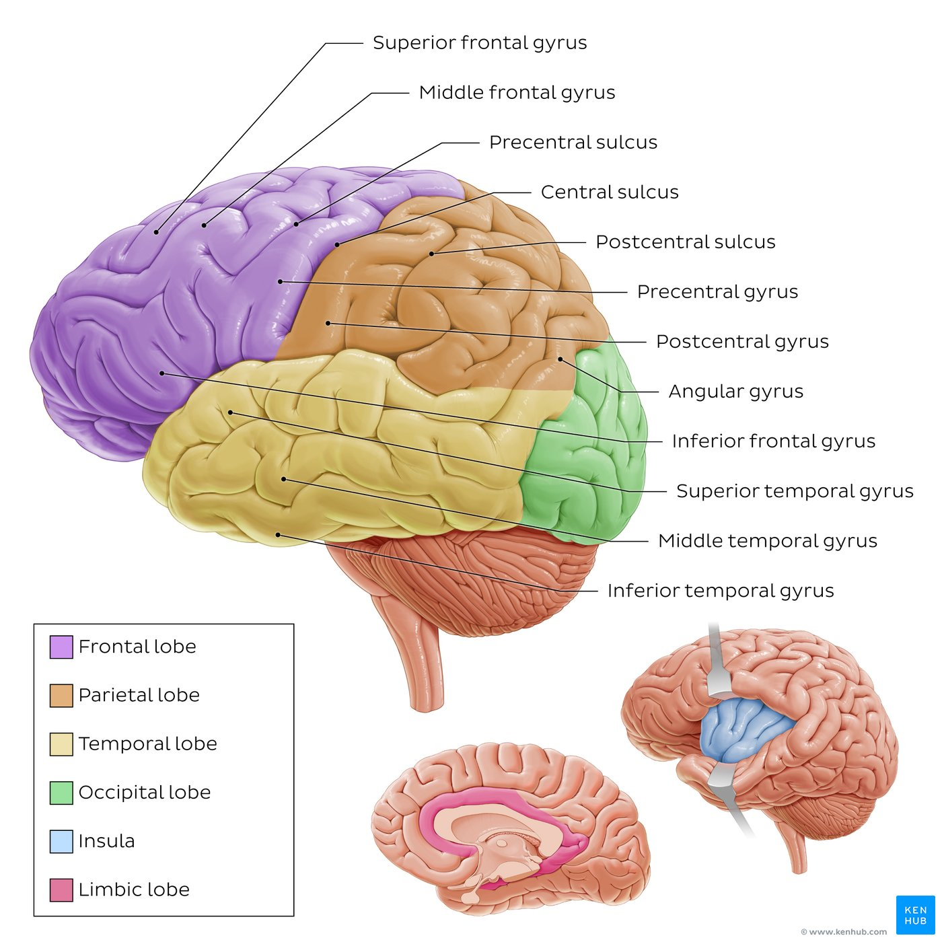
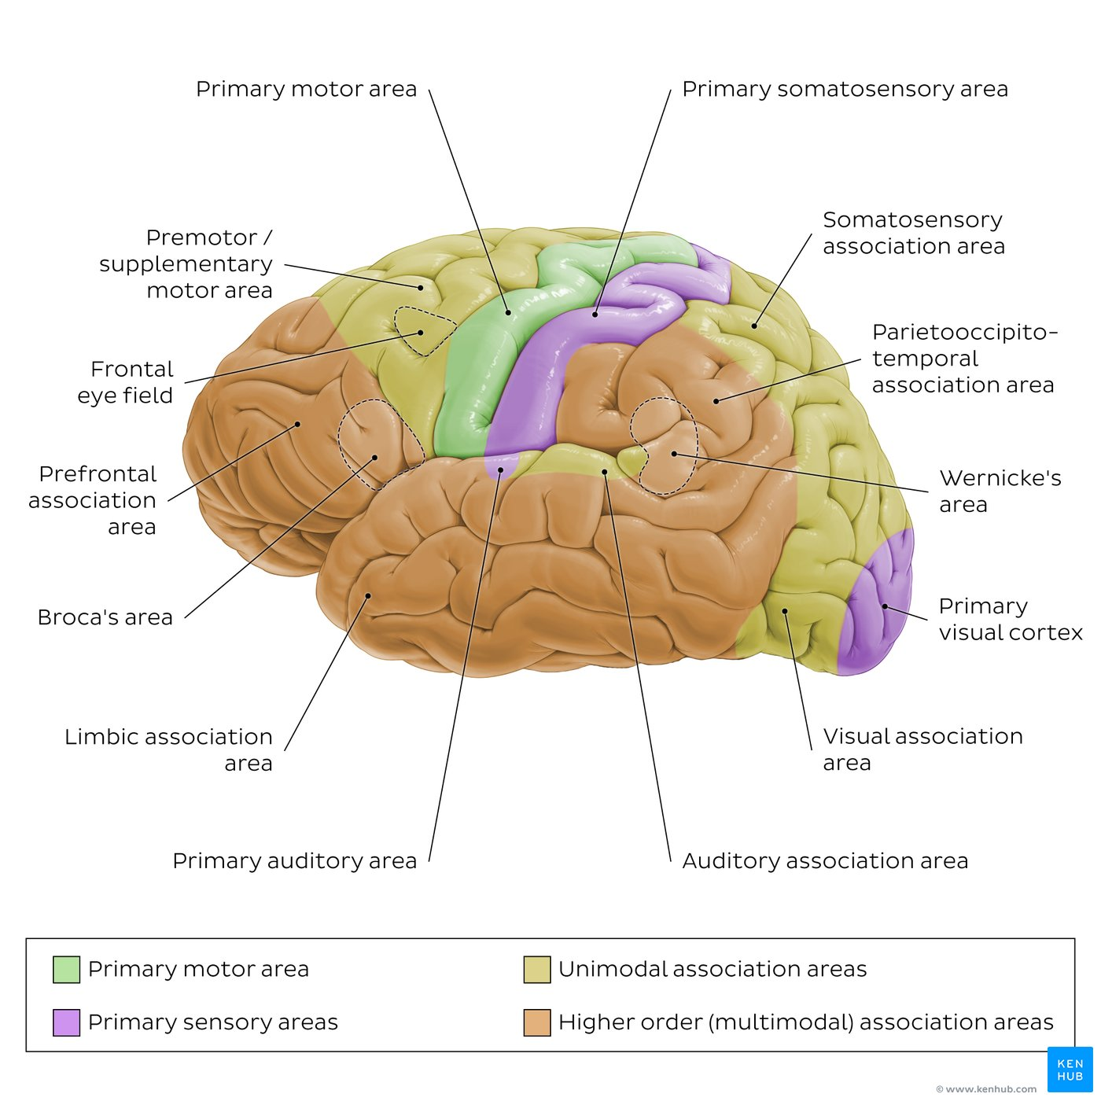
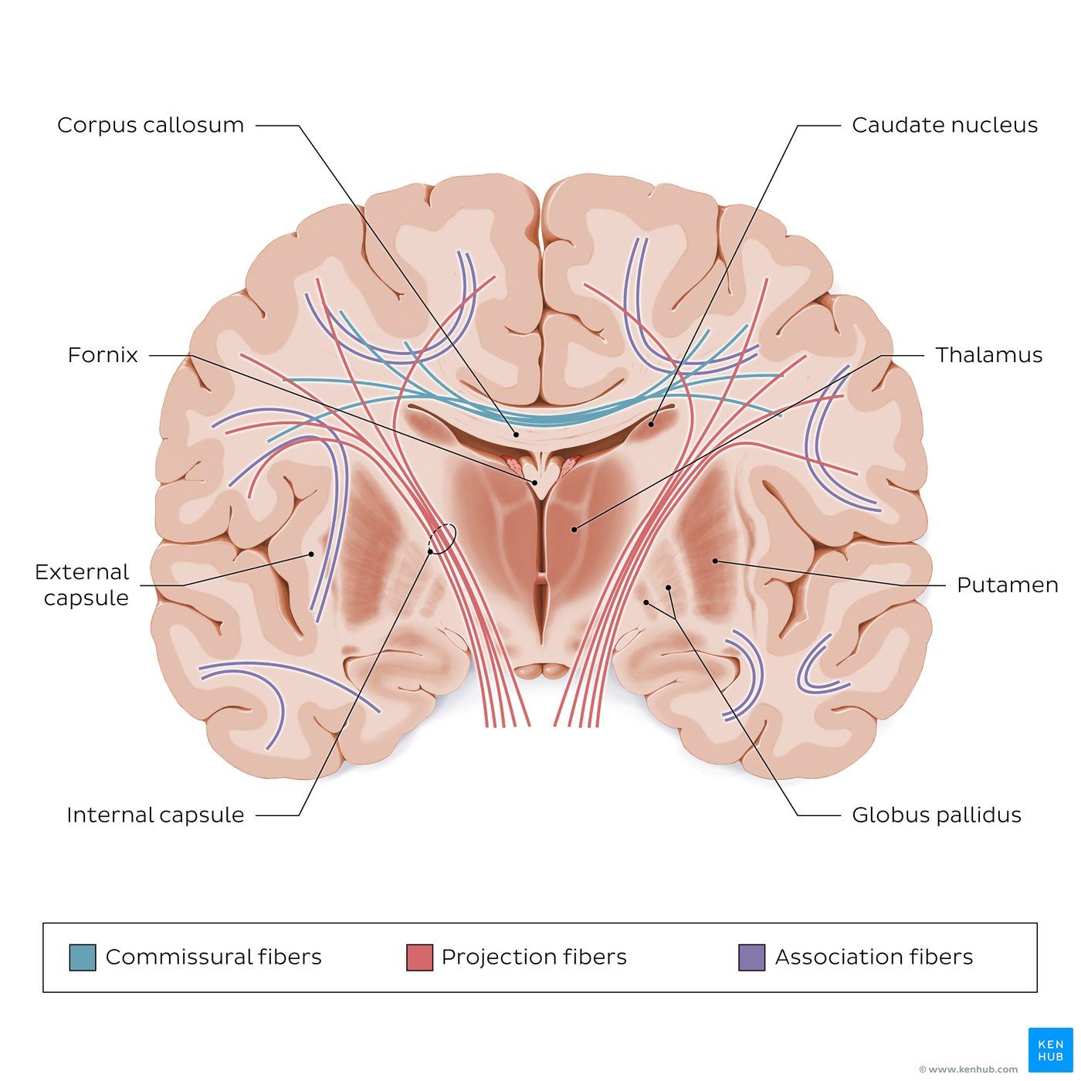

Slide 5
Key facts about the lobes of the cerebrum
Frontal lobe | Anterior to central sulcus, superior to lateral sulcus Major gyri: Precentral gyrus, superior, middle, inferior frontal gyri Control of voluntary movement, involved in attention, short term memory tasks, motivation, planning, speech
Parietal lobe | Posterior to the central sulcus Major gyri/areas: postcentral gyrus, superior parietal lobule, inferior parietal lobule (angular gyrus) Processing of somatosensory input (touch, pain, pressure and temperature), integration of other sensory input (taste, hearing, sight, and smell), visuospatial mapping and attention, processing language and numerical relationships
Temporal lobe | Lateral surface of cerebrum, inferior to lateral sulcus Main gyri: Superior, middle, inferior temporal gyri Decoding sensory input (visual and auditory) into derived meanings for retention of visual memory and language comprehension
Occipital lobe | Posterior to parietal/temporal lobes Main gyri: occipital gyri Center for visual processing
Insular lobe | Deep to temporal/parietal/frontal lobes Main gyri: Long/short gyri of insula Processing and integration of taste sensation, visceral and pain sensation and vestibular functions
Limbic lobe | Medial surface of each hemisphere, surrounding corpus callosum Main gyri: paraterminal, cingulate, parahippocampal gyri Modulation of emotions, modulation of visceral and autonomic functions, learning, memory

Slide 6
Key facts about the motor, sensory and association areas
Primary motor area | Precentral gyrus (frontal lobe) – planning and execution of movement
Primary somatosensory area | Postcentral gyrus (parietal lobe) – processing of somatic sensory input
Primary visual area | Occipital lobe – processing of visual input
Primary auditory area | Superior parietal lobule – processing of auditory input
Olfactory area | Limbic/medial temporal lobes – processing of olfactory input
Gustatory area | Insular/parietal lobes – processing of taste stimuli
Vestibular areas | Parietal/temporal lobes – equilibrium and balance
Premotor area | Anterior to primary motor cortex – complex movement
Somatosensory association area | Posterior to primary somatosensory cortex – integration of somatic sensory information
Visual association area | Anterior part of occipital lobe, posterior parts of parietal/temporal lobes – spatial orientation, perception of depth, location, movement and velocity of objects in space
Parietaltemporo-occipital association area | Posterior parts of parietal/occipital/temporal lobes –interpretation of signals from surrounding somatosensory, visual and auditory areas (e.g. visuospatial awareness, visual language (reading), naming of objects), learning of fine motor skills
Wernicke’s area | Posterolateral part temporal lobe (usually left – language (comprehension)
Temporal association area | Anterior pole of temporal lobe / processes of recognition/association, behavior, emotions, and motivation
Prefrontal area | Anterior frontal – higher mental functions, behavior, personality
Frontal eye fields | Anterior to premotor cortex – eye movements
Broca’s area | Inferolateral frontal lobe (usually left hemisphere) – language (production/word formation)
Limbic association area | Anterior pole of temporal lobe, ventral part of frontal lobe, cingulate gyrus – processes of recognition/association, behavior, emotions, and motivation

Slide 7
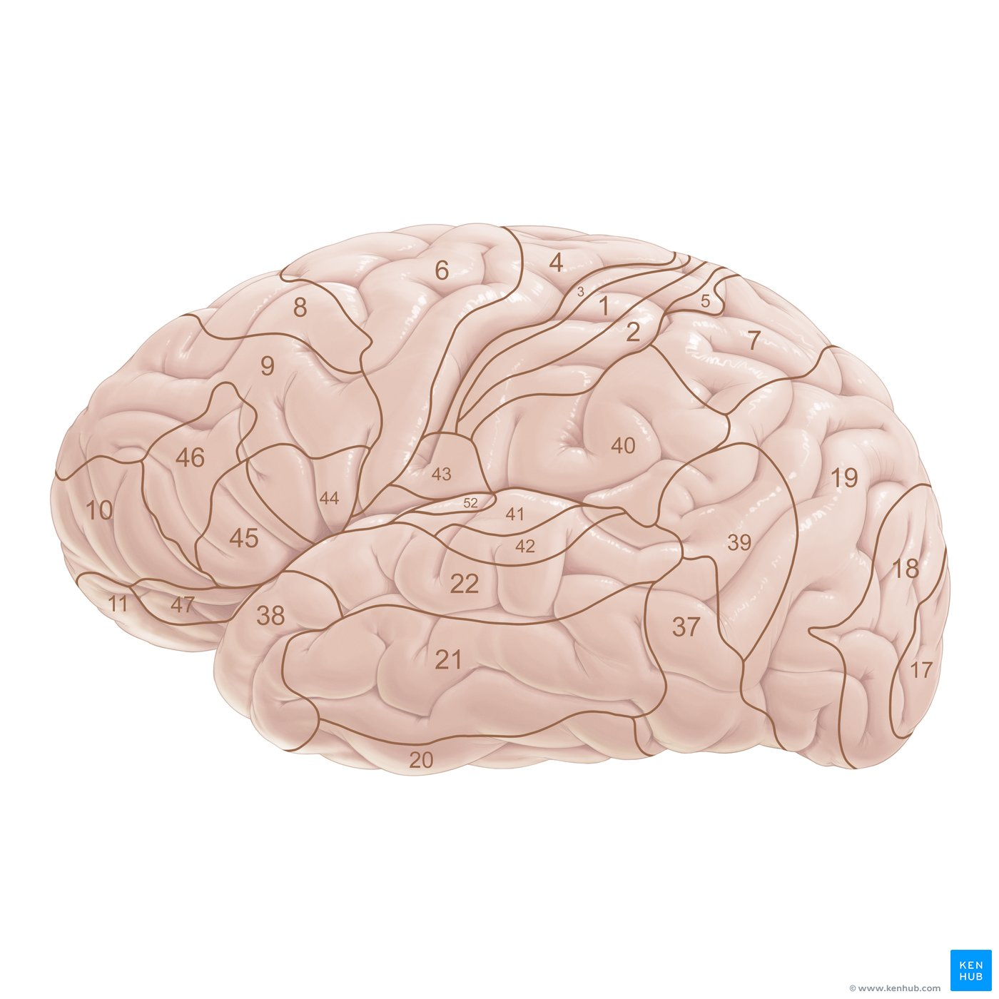
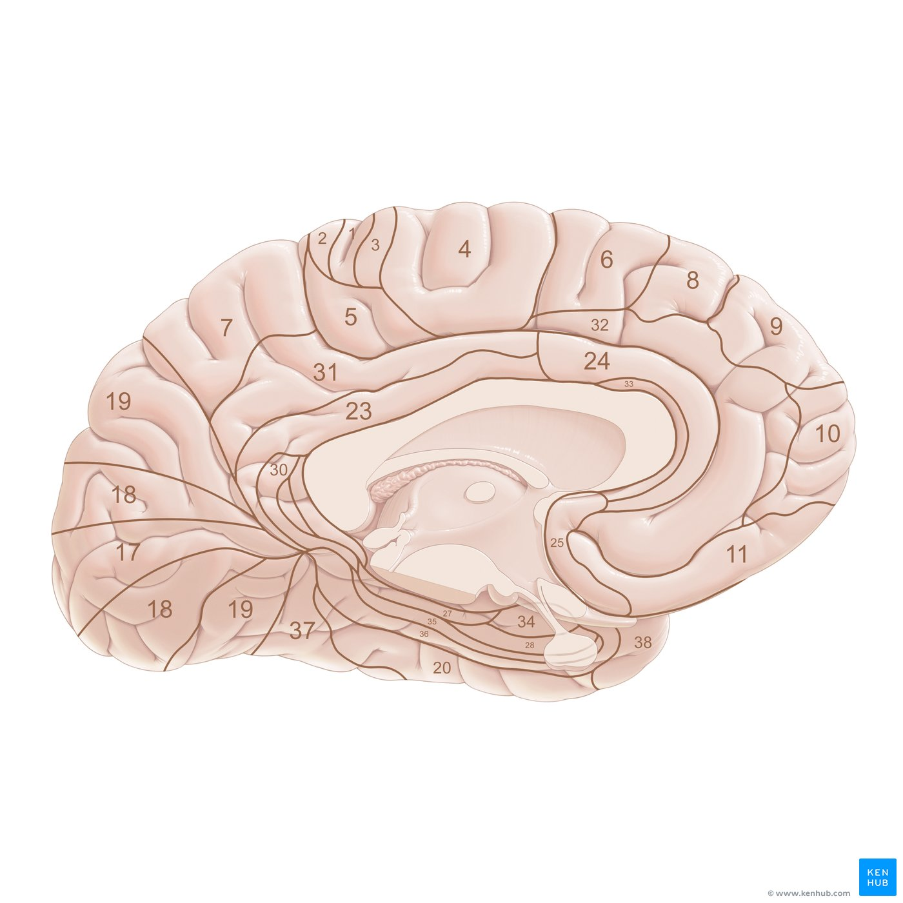
Broadman areas
The cerebral cortex can be mapped into fifty-two territories or regions called Brodmann areas, which are defined on the basis of the brain’s cytoarchitecture (i.e. cellular composition and organization). Forty-four of these areas are found in humans, while the remaining eight relate to the primate brain.
Brodmann areas can be didactically divided into groups according to the lobes of the brain: frontal, parietal, temporal, occipital and insular. They can also be considered in relation to cortical functions. For example, the main area of the occipital lobe is Brodmann area 17 (striate area) which corresponds to the primary visual cortex that is responsible for the visual stimuli processing.

Slide 8
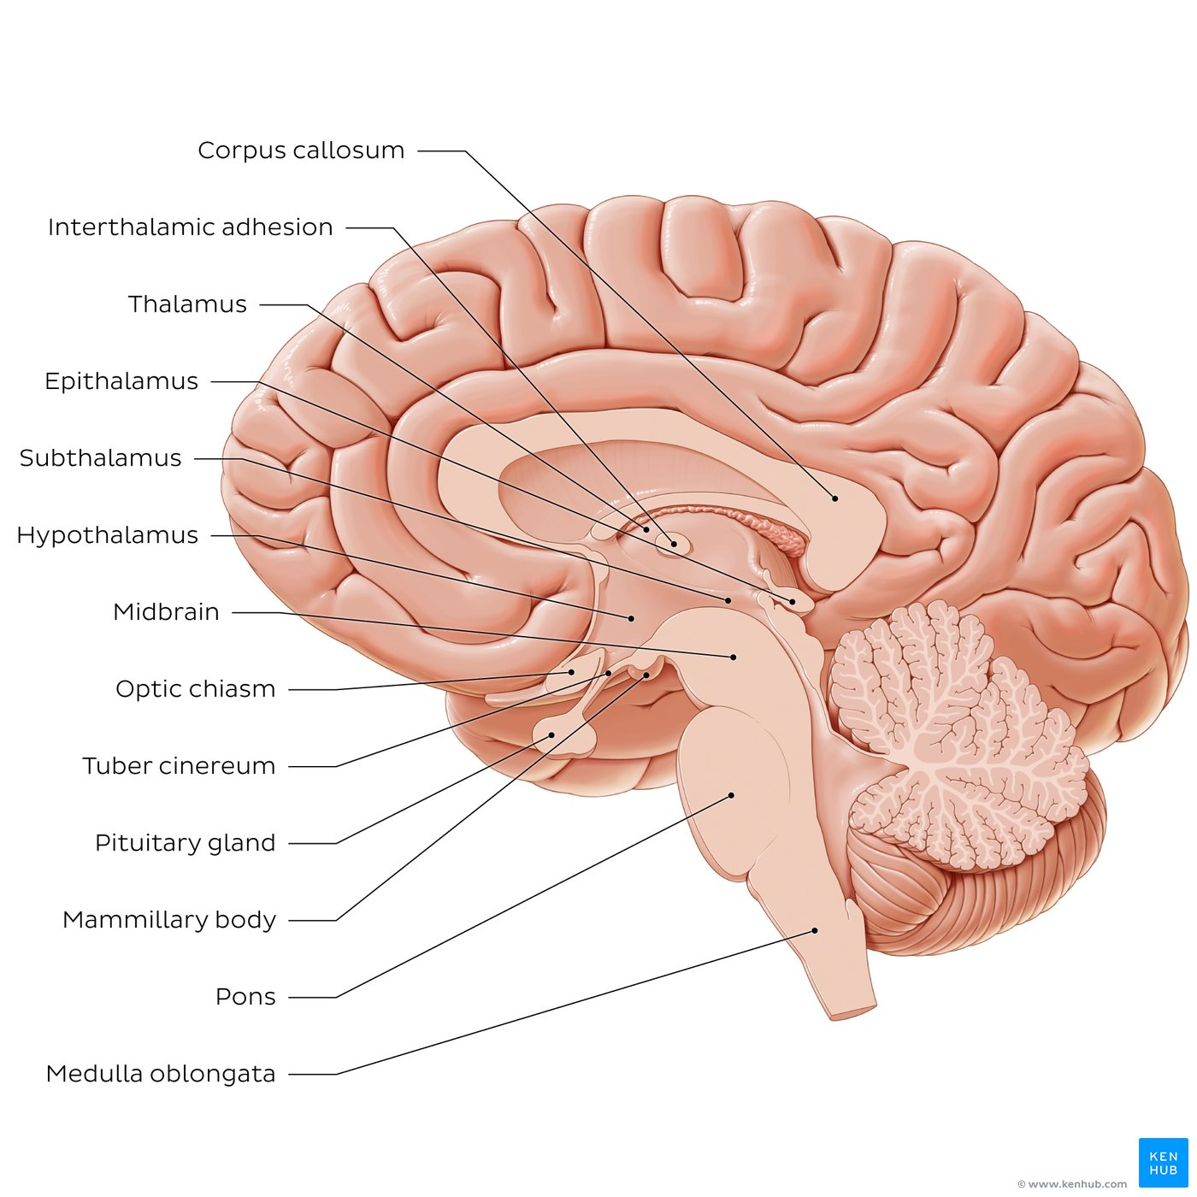
Telencephalon - Diencephalon
The human brain is divided into several specific parts which include:
Cerebrum (forebrain)
Brainstem
Cerebellum
The cerebrum (forebrain) can be further divided into two parts: the telencephalon (with the cerebral cortex, the white matter and the basal ganglia) and the diencephalon that occupies the central region of the brain (around the third ventricle).
The diencephalon is further divided into several distinct parts, namely the:
Thalamus: occupies the central and largest portion of the diencephalon. It is an ovoid, bilateral gray matter structure, found in the center of the brain, just superior to the brainstem. The thalamus has many important functions. it is considered to be the central relay station of the brain, that relays limbic, sensory and motor information between the cerebral cortex and the rest of the nervous system.
Subthalamus: lies inferior to the posterior part of the thalamus, posterior and lateral to the hypothalamus. The largest division of the subthalamus is the subthalamic nucleus which plays a fundamental role in the circuitry of the basal ganglia (i.e. movement regulation).
Epithalamus: a tiny, dorsal part of the diencephalon that participates in the formation of the roof of the third ventricle. The structures that make up the epithalamus are the pineal gland and habenular nuclei.
Hypothalamus: the inferiormost part of the diencephalon, located anteroinferior to the thalamus. It can be divided into several regions, each of which is responsible for certain functions. In general, it forms connections with different body systems (endocrine, autonomic and limbic) through which it controls some vital functions of the human body (e.g. homeostasis, energy consumption, hunger, awareness, etc.).

Slide 9
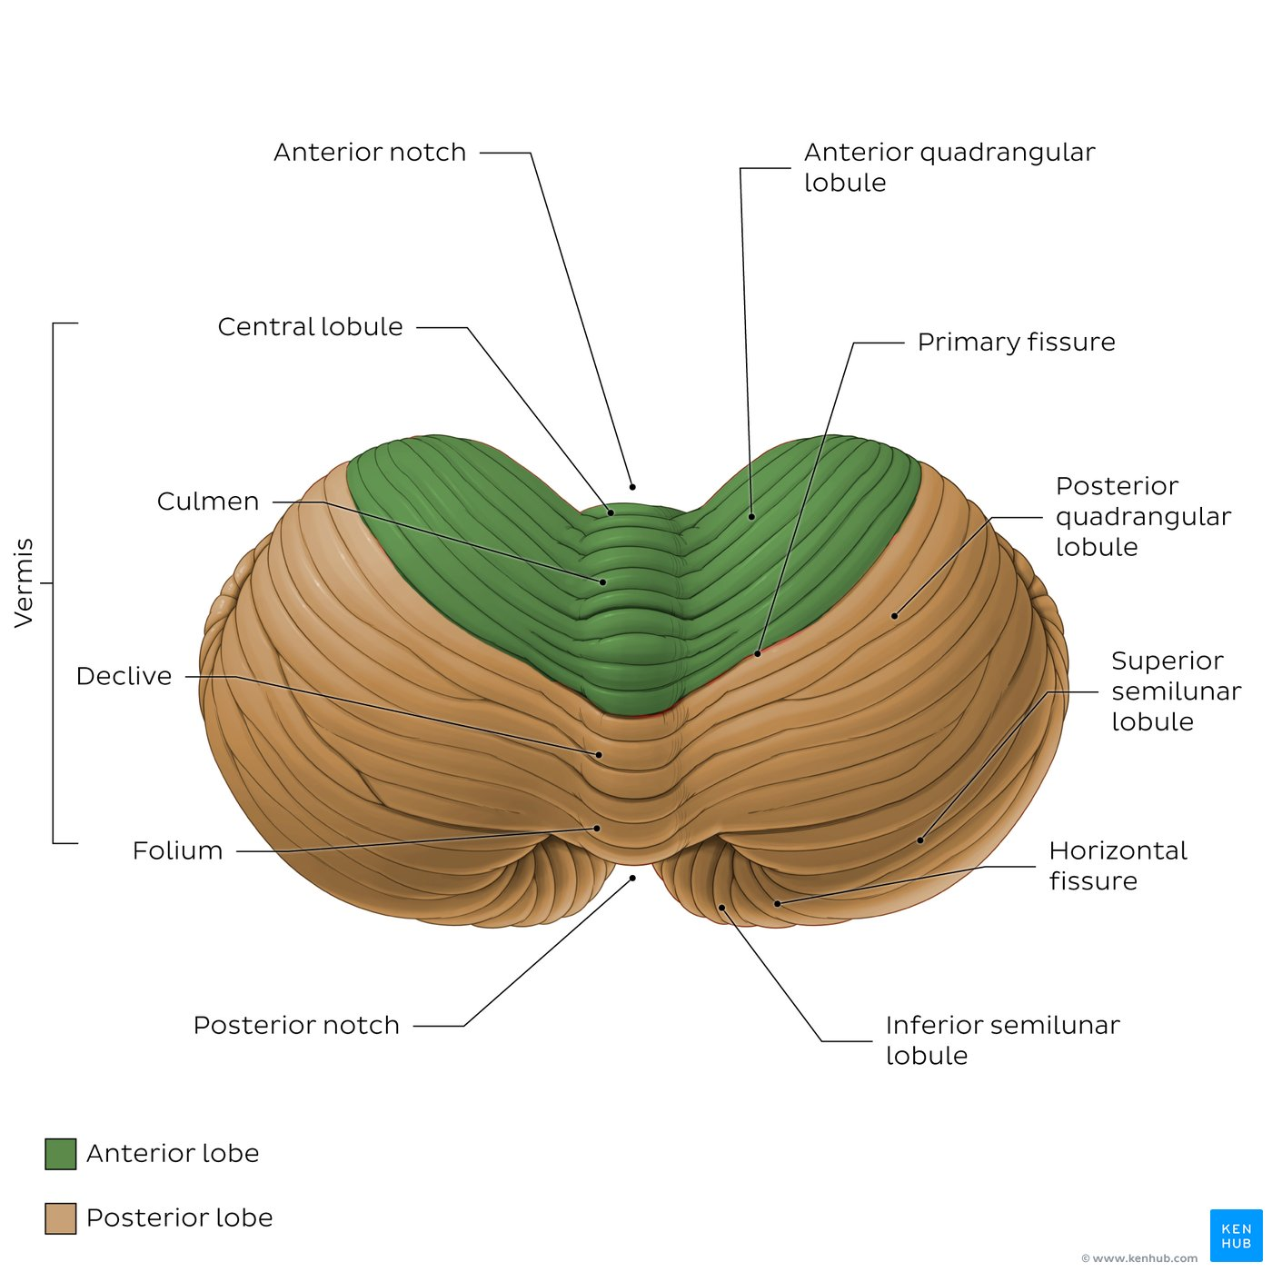
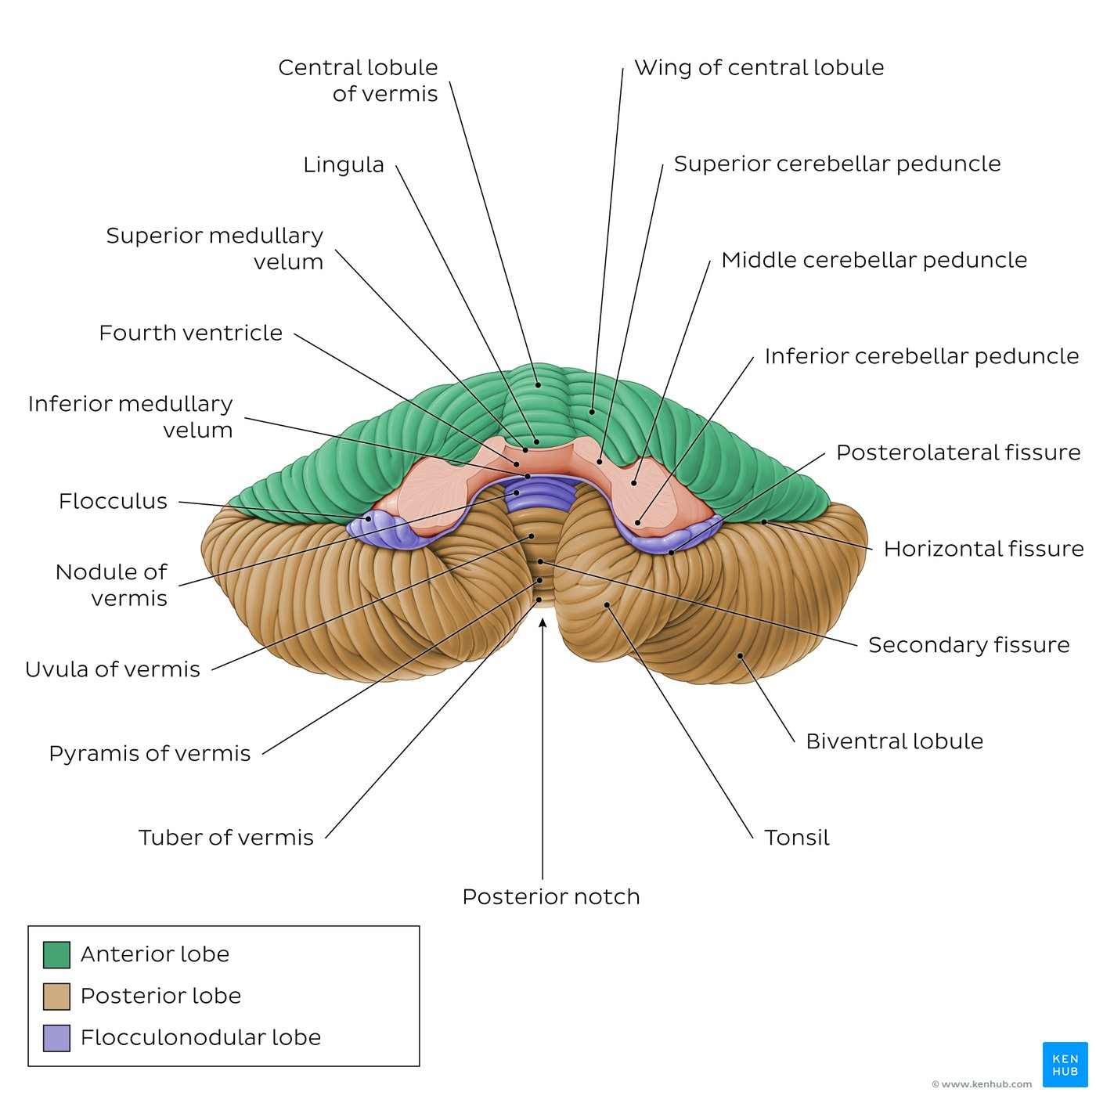
Cerebellum
The cerebellum is the part of the brain which lies posterior (dorsal) to the pons and medulla. It sits in the posterior cranial fossa beneath the occipital lobe of the cerebrum, from which it is separated by the tentorium cerebelli. It is connected to the brainstem by three sets of large bilateral nerve fiber bundles known as cerebellar peduncles.
The cerebellum is built around a central vermis which is flanked on either side by a cerebellar hemisphere. It has three surfaces: superior (tentorial), anterior (petrosal) and inferior (suboccipital). All are highly convoluted and bear deep fissures that divide the cerebellum into lobes that are further subdivided into lobules. The surface of the cerebellum is much more tightly folded compared to the cerebral cortex and is marked with fine gyri known as folia.
The cerebellum receives input from:
peripheral receptors and motor centers in the spinal cord
the visual and vestibular apparatus
as well as cerebrum and brainstem.
It is responsible for integrating these inputs to ensure coordination of movement, balance and posture, as well as motor learning.

Slide 10
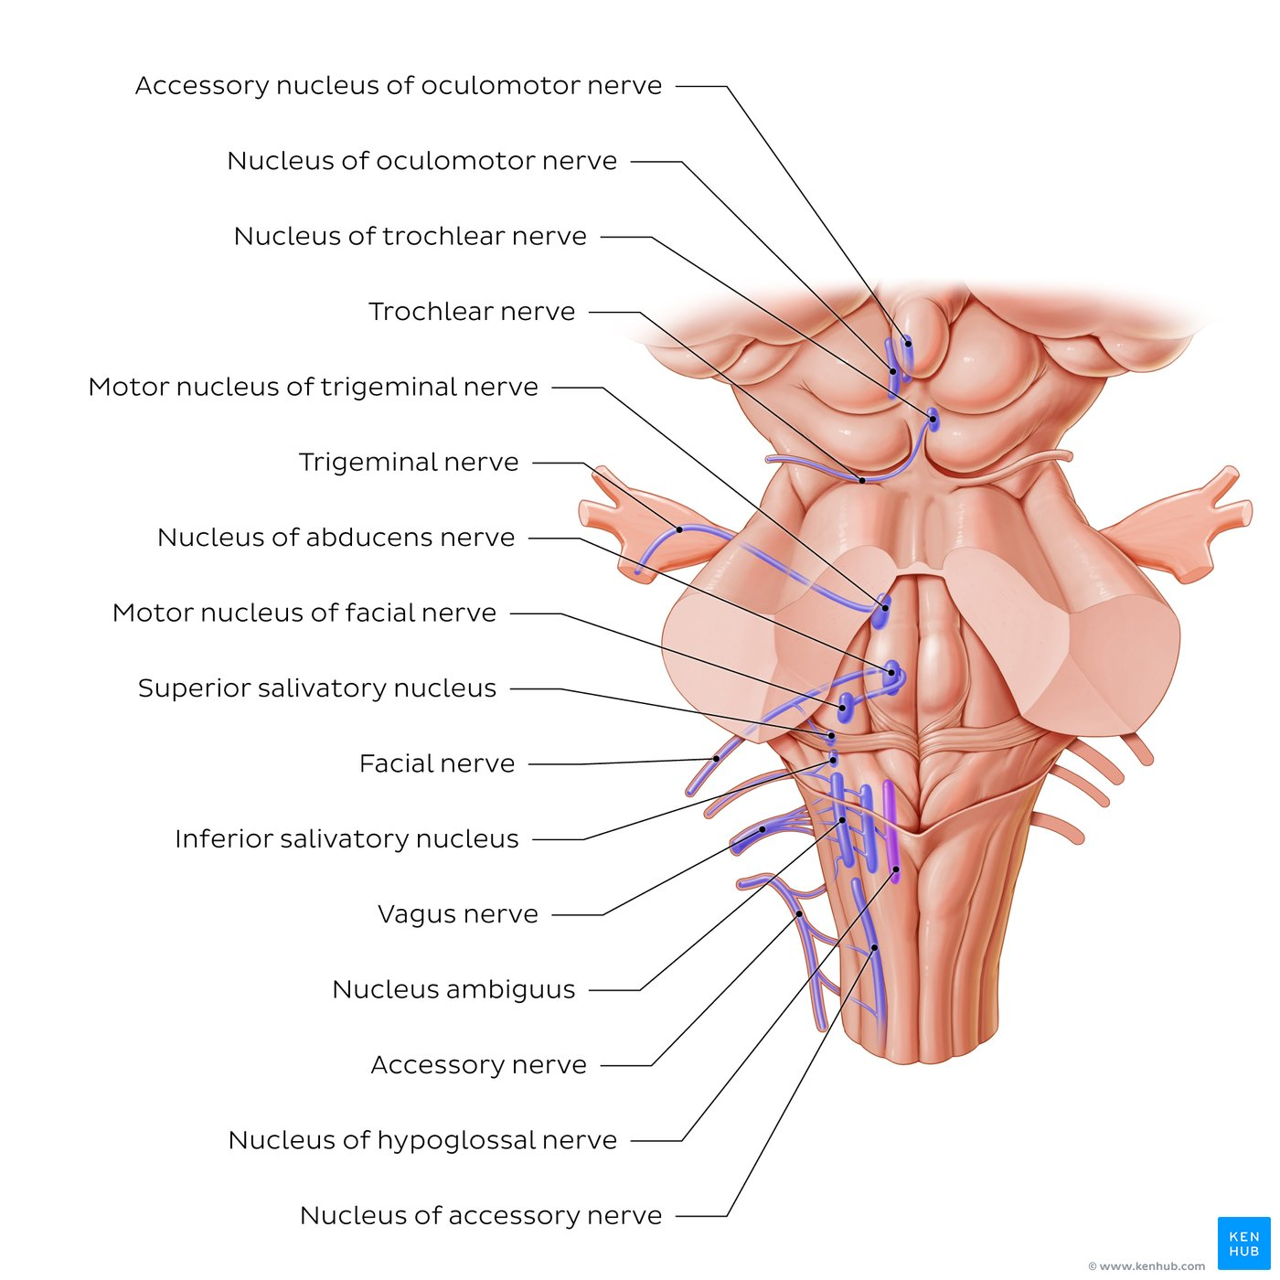
Brainstem
The brainstem is a stalk-like projection which extends caudally from the base of the diencephalon, connecting it with the spinal cord. It is the oldest part of the brain and is composed of three parts: the midbrain, pons and medulla oblongata.
The midbrain is the shortest segment of the brainstem. It extends caudally from the base of the the diencephalon to the pons. Its functions are associated with motor coordination (in particular eye movements), visual and auditory processing, arousal/consciousness as well as behavioural responses to fear and danger.
The pons is located between the midbrain and medulla oblongata and forms the largest component of the brainstem. It houses the nuclei of cranial nerves V-VIII, as well as the pontine nuclei which facilitate corticopontocerebellar communication. It also participates in the regulation of sleep and breathing.
The medulla oblongata is the narrowest and most caudal part of the brainstem. It has a tapered appearance that extends from the pons to the spinal cord. It houses the nuclei of cranial nerves IX-X, and XII, and is involved in controlling respiratory function, the cardiovascular system, as well as gastrointestinal and digestive activities.

Slide 11
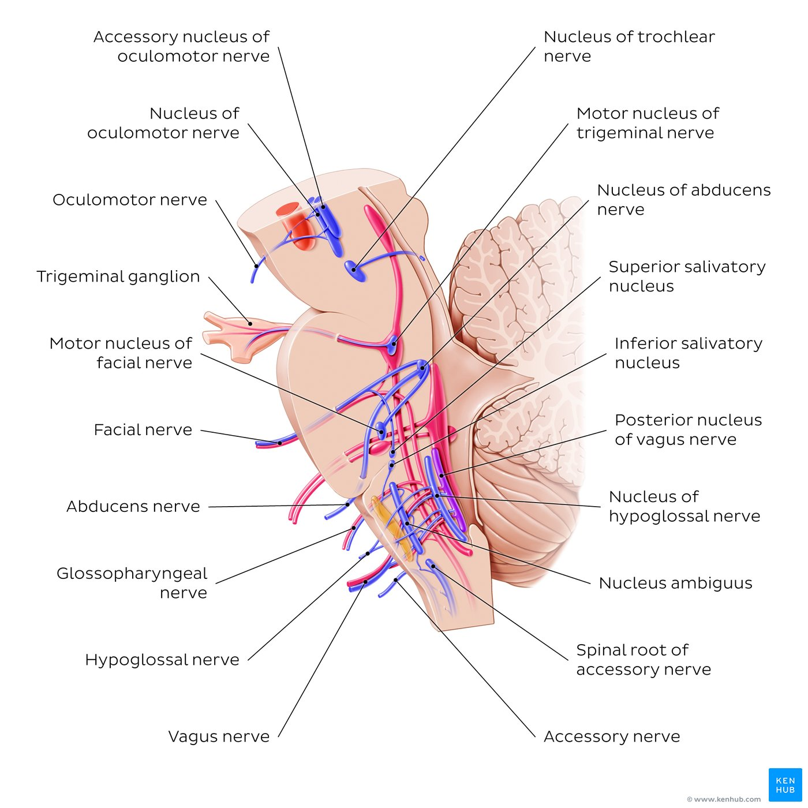
Cranial nerve nuclei
The cranial nerve nuclei are collections of neuronal cell bodies dispersed throughout the brainstem. They function to either receive afferent inputs from cranial nerve fibers or give off efferent outputs which travel along the cranial nerves to target structures.
The cranial nerve nuclei can be divided into seven different modalities based on the information they carry to and from their target tissues, impulse type and specificity or exclusivity to cranial nerves:
Efferent modalities
General somatic efferent (GSE): skeletal muscles of the head and neck (e.g. extraocular muscles and muscles of the tongue).
General visceral efferent (GVE): smooth muscles of gut and autonomic motor (e.g. smooth muscles of the salivary glands and iris sphincter muscle and the ciliary muscle.
Special visceral efferent (SVE): muscles derived from pharyngeal arches, specific to cranial nerves.
Afferent modalities
General somatic afferent (GSA): general sensation from the skin.
General visceral afferent (GVA): general sensation from viscera.
Special somatic afferent (SSA): senses derived from ectoderm, specific to cranial nerves (e.g. sight, sound, balance).
Special visceral afferent (SVA): senses derived from endoderm, specific to cranial nerves (e.g. taste, smell).
While cranial nerves can carry a mixture of both motor and sensory fibers, cranial nerve nuclei can only be motor or sensory. Therefore, cranial nerves may be associated with more than one nucleus and some cranial nerves may even share the same nucleus.
The olfactory nerve (CN I) and the optic nerve (CN II) arise outside the brainstem and therefore, are the only cranial nerves which are not associated with cranial nerve nuclei.

Slide 12
Key points about the cranial nerve nuclei
Oculomotor nerve (CN III) | Nucleus of oculomotor nerve (GSE), accessory nucleus of oculomotor nerve (GVE)
Trochlear nerve (CN IV) | Nucleus of trochlear nerve (GSE)
Trigeminal nerve (CN V) | Motor nucleus of trigeminal nerve (SVE), principal nucleus of trigeminal nerve (GSA), spinal nucleus of trigeminal nerve (GSA), mesencephalic nucleus of trigeminal nerve (GSA)
Abducens nerve (CN VI) | Nucleus of abducens nerve (GSE)
Facial nerve (CN VII) | Nucleus of facial nerve (SVE), superior salivatory nucleus (GVE), nucleus of solitary tract (GVA, SVA), spinal nucleus of trigeminal nerve (GSA)
Vestibulocochlear nerve (CN VIII) | Cochlear nuclei (SSA), vestibular nuclei (SSA)
Glossopharyngeal nerve (CN IX) | Nucleus ambiguus (SVE), inferior salivatory nucleus (GVE), nucleus of solitary tract (GVA, SVA), spinal nucleus of trigeminal nerve (GSA)
Vagus nerve (CN X) | Posterior nucleus of vagus nerve (GVE), nucleus ambiguus (SVE), nucleus of solitary tract (GVA, SVA), spinal nucleus of trigeminal nerve (GSA)
Accessory nerve (CN XI) | Nucleus ambiguus (SVE)
Hypoglossal nerve (CN XII) | Nucleus of hypoglossal nerve (GSE)

Slide 13
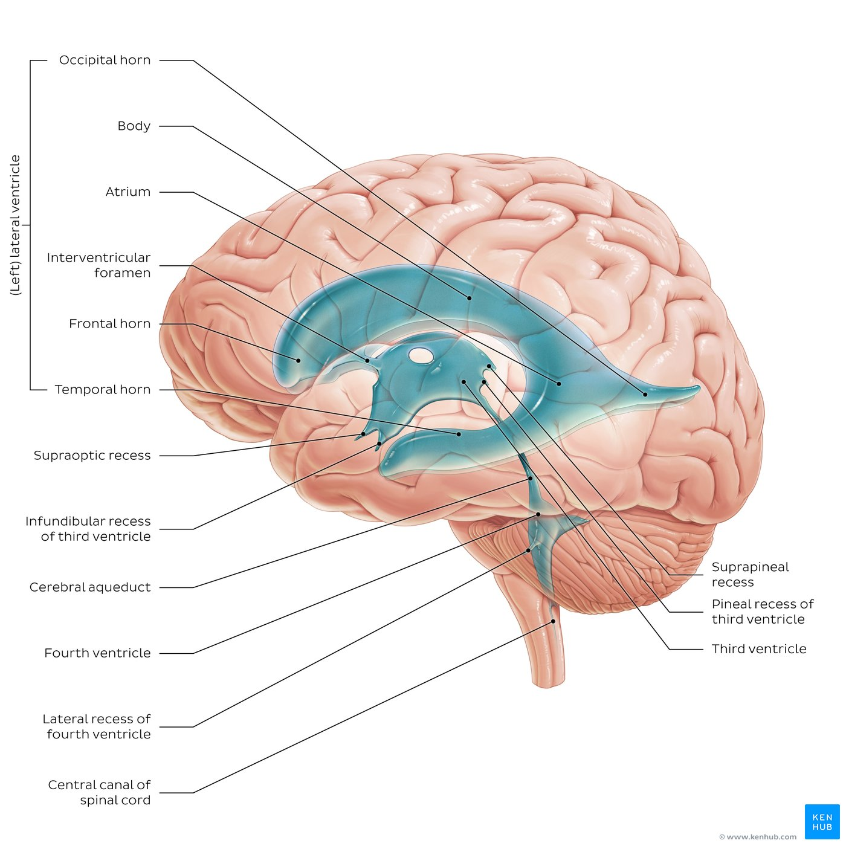
Ventricles of the brain
The ventricles of the brain are an interconnected network of cavities filled with cerebrospinal fluid (CSF) located within the brain parenchyma.
The ventricular system consists of
the two lateral ventricles,
the third ventricle
the fourth ventricle.
The choroid plexuses, located within each ventricle, produce CSF which fills the ventricles and subarachnoid space. This fluid cushions the brain and spinal cord from injury and also serves as a nutrient delivery and waste removal system for the brain.

Slide 14
Key facts about the production and circulation of cerebrospinal fluid
Cerebrospinal fluid (CSF) | Definition: Clear, plasma-like fluid, that circulates within the system of cavities found throughout the CNS Produced by: Choroid plexus Drained by: Arachnoid granulations Amount in circulation: Approx 150 milliliters
Choroid plexus | Location: Floor of lateral ventricles/roofs of third and fourth ventricles Functions: Production and secretion of CSF, forming a blood-CSF barrier, secretion of various growth factors, facilitate the brain development, protection from harmful toxins and microbes
Subarachnoid cisterns | Infratentorial cisterns: Basal/ventral cisterns: Premedullary cistern, prepontine cistern Lateral cisterns: Lateral cerebellomedullary cistern, cerebellopontine cistern Dorsal cisterns Posterior cerebellomedullary cistern (cisterna magna) Cisterns at the level of the tentorium cerebelli: Basal/ventral cisterns: Interpeduncular cistern Lateral cisterns: Ambient cistern, superior cerebellar cistern Dorsal cisterns: Quadrigeminal cistern Supratentorial cisterns: Basal cisterns: Hypophyseal cistern, chiasmatic cistern, cistern of lamina terminalis Lateral cisterns: Olfactory cistern, cisterns of lateral cerebral fossa, central sulcus, cistern of central sulcus Dorsal cisterns: Pericallosal cistern, cistern of transverse fissure
Arachnoid granulations | Definition: Protrusions of arachnoid mater that pierce dura mater and protrude into lumina of dural venous sinuses Function: Drainage of cerebrospinal fluid

Slide 15
Peripheral nervous system (PNS): Nerves, ganglia and plexuses
The peripheral nervous system (PNS) is composed of all the nervous structures outside the brain and spinal cord. It is functionally divided into somatic (voluntary) and autonomic (involuntary) nervous systems, with the latter being further subdivided into sympathetic, parasympathetic and enteric nervous systems.
The PNS consists of all the nerves, ganglia and plexuses of the body. A nerve consists of a bundle of many nerve fibers (i.e., axons), their connective tissue coverings and nourishing blood vessels. Nerve fibers that carry information from the periphery towards the CNS are called afferent or sensory, while the ones transmitting impulses from the CNS to the periphery are known as efferent or motor.
Nerves are also classified according to the place where they exit the CNS. Cranial nerves emerge from the brain while spinal nerves emerge from the spinal cord. There are 12 pairs of cranial nerves and 31 pairs of spinal nerves.
A ganglion is a group of neuron cell bodies outside the CNS. There are two main types of ganglia: sensory ganglia, which contain cell bodies of neurons responsible for sending information from the periphery to the CNS, and autonomic ganglia, which include sympathetic (close to the spinal cord) and parasympathetic (near or within the viscera) ganglia.
Finally, a plexus is a branching network of interconnected nerves. There are two main types of plexus: the spinal nerve plexuses, which are formed by the intersecting subdivisions of the anterior rami of the spinal nerves, and the autonomic plexuses which can be found in the thorax, abdomen, and pelvis where they are responsible for regulating the activity of visceral organs.

Slide 16
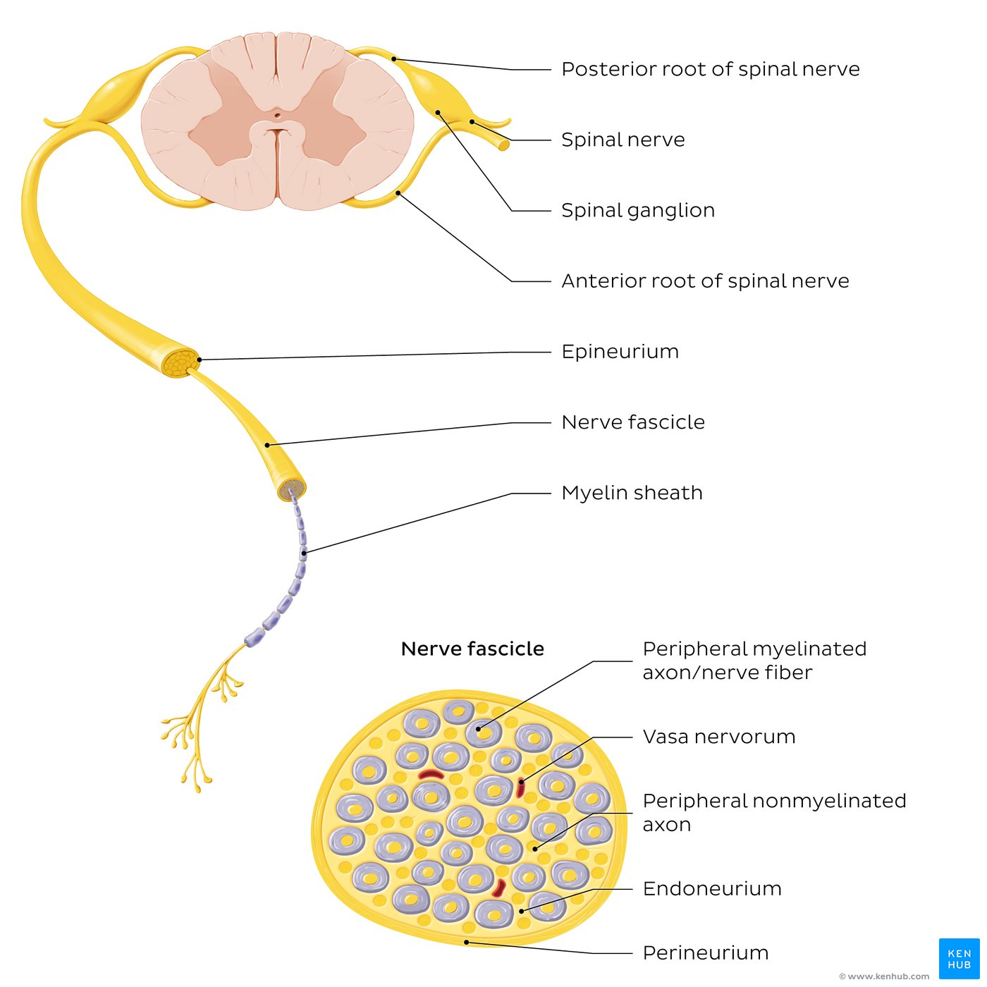
Nerve structure
A nerve is formed by a bundle of axons (or nerve fibers) outside the CNS.
These nerve fibers can be myelinated (surrounded by a myelin sheath) or nonmyelinated.
Nerves are also composed of connective tissue coverings, as well as nourishing blood vessels (vasa nervorum).
The three layers of connective tissue are the epineurium, surrounding the outer surface of a nerve, the perineurium, surrounding each nerve fascicle (which is a group of axons), and the endoneurium, which surrounds each individual axon.
Spinal nerves arise from the spinal cord as anterior and posterior roots whereas cranial nerves arise from the brain.

Slide 17
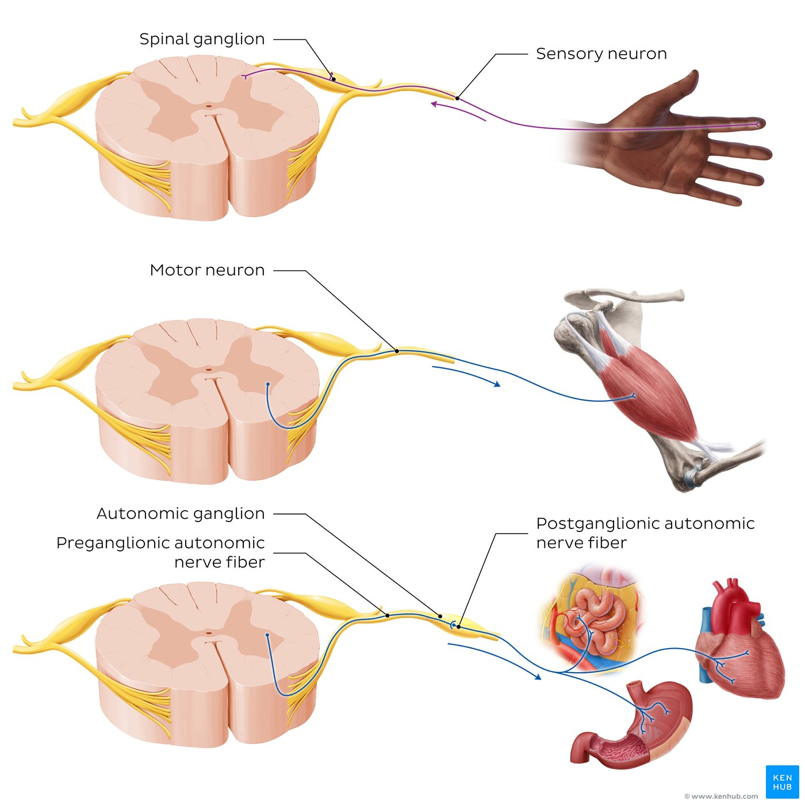
Types of nerves and ganglia
Spinal nerves contain sensory and motor neurons. Sensory (or afferent) neurons carry information from the periphery to the CNS. The sensory axons enter the spinal cord via the posterior spinal nerve root. The cell bodies of these neurons are located in the spinal ganglion, which is an enlargement of the posterior root and is classified as a sensory ganglion.
﻿
Motor (or efferent) neurons carry information from the CNS to the periphery. The motor fibers, which can be either somatic and autonomic, emerge from the spinal cord via anterior spinal nerve root. The cell bodies of these neurons are located in the gray matter of the spinal cord. Autonomic impulses, which innervate smooth and cardiac muscle, as well as glandular cells, are conveyed through pre- and postganglionic autonomic nerve fibers. The synapse between these two types of neurons occurs in an autonomic ganglion, where the cell bodies of the postganglionic neuron are located.

Slide 18
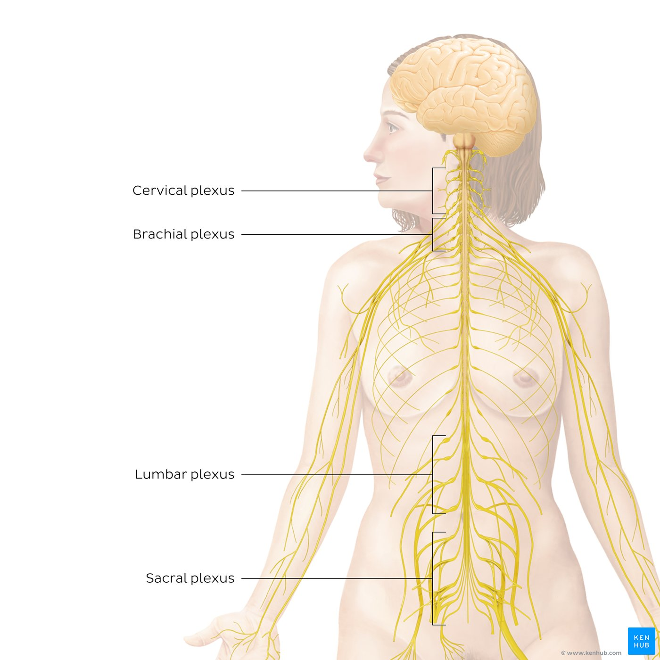
Spinal plexuses
Spinal plexuses are formed by the anterior rami of spinal nerves.
The cervical plexus (C1-C4) supplies nerves to the posterior head and neck.
the brachial plexus (C5-T1) supplies nerves to the upper limb.
the lumbar plexus (T12-L5) supplies nerves to the anterior lower limb.
the sacral plexus (S1-S4) supplies nerves to the posterior lower limb.
the coccygeal plexus (S4-S5, Co1; not shown) supplies nerves to the pelvic and coccygeal regions.

Slide 19
Key points about peripheral nervous system
Definition | A division of the nervous system composed of all nervous structures outside the brain and spinal cord
Function | Transmits motor and sensory information between the CNS and periphery
Functional components | Somatic nervous system (voluntary) Autonomic nervous system (involuntary) Sympathetic nervous system Parasympathetic nervous system Enteric nervous system (gastrointestinal system)
Anatomical components | Ganglia Sensory ganglia (dorsal root ganglion, sensory ganglia of cranial nerves) Autonomic ganglia (sympathetic ganglion, parasympathetic ganglion) Nerves (sensory, motor or mixed) Cranial nerves (CN I-XII) Spinal nerves (31 pairs of spinal nerves) Autonomic (visceral) nerves Plexuses Spinal nerve plexuses (cervical, brachial, lumbar, sacral and coccygeal plexuses) Autonomic plexuses

Slide 20
Purely Motor
Purely Sensory
Mixed
Oculomotor (ΙΙΙ)
Trochlear (ΙV)
Abducens (VI)
Accessory (ΧΙ)
Hypoglossal (ΧΙΙ)
Olfactory (Ι)
Optic (ΙΙ)
Vestibulocochlear (VΙΙI)
Trigeminal (V)
Facial (VI)
Glossopharyngeal (IX)
Vagus (Χ)
Sensory fibers that transmit sensation from the skin/mucous membranes and from the viscera (general somatic afferent and general visceral afferent axons, respectively). Fibers that transmit the special senses (sensory fibers).
Motor fibers for striated and smooth muscles (general somatic efferent and general visceral efferent axons, respectively)
Efferent and afferent fibers

Slide 21
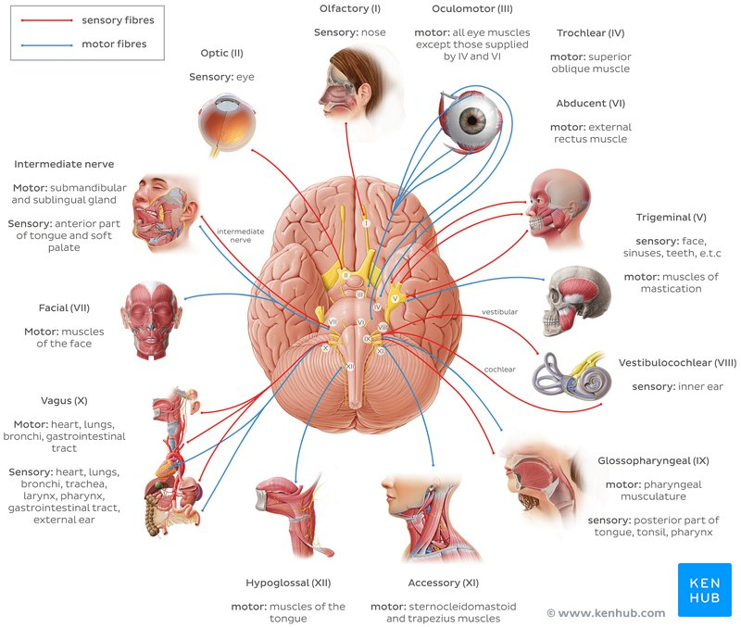

Slide 22
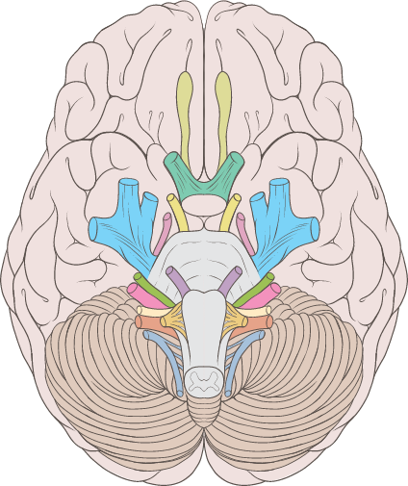
Cranial Nerves
Ι. Olfactory n.
ΙΙ. Optic n.
ΙΙΙ. Oculomotor n.
ΙV. Trochlear n.
V. Trigeminal n.
VI. Abducens n.
VII. Facial n.
VIII. Vestibulocochlear n.
ΙΧ. Glossopharyngeal n.
Χ. Vagus n.
ΧΙΙ. Hypoglossal n.
ΧΙ. Accessory n.

Slide 23
Key points about cranial nerve modalities
Nerve fiber terminology | Efferent (motor) Carries information from the brain to the periphery Afferent (sensory) Carries information from the periphery to the brain Mixed Carries information both ways Special Carries information from/to the special senses (vision, smell, taste, hearing and balance) General Carries information from/to any other part of the body, except the special senses Somatic Carries information to/from the skin or skeletal muscles Visceral Carries information to/from internal organs

Slide 24
Nerve fiber types/modalities | General somatic afferent (GSA) Conveys general sensation from skin (a.k.a. [general] somatic sensory) General visceral afferent (GVA) Conveys general sensation from viscera (a.k.a. [general] visceral sensory) Special somatic afferent (SSA) Conveys senses derived from ectoderm (e.g. sight, sound, balance, smell) (a.k.a. special somatic sensory) Special visceral afferent (SVA) Conveys senses derived from endoderm (i.e.. taste) (a.k.a. special visceral sensory) General somatic efferent (GSE) Conveys motor innervation for skeletal muscles (a.k.a. [general] somatic motor) General visceral efferent (GVE) Conveys motor innervation for smooth muscle, cardiac muscle and glands (a.k.a. [general] visceral motor) Special visceral efferent (SVE) Conveys motor innervation for muscles derived from pharyngeal arches (a.k.a. special visceral motor, branchial motor)

Slide 25
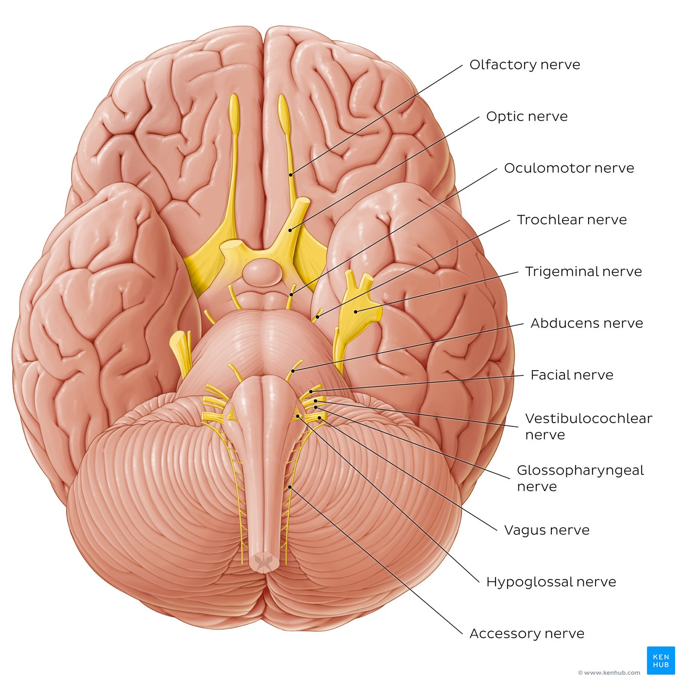
12 cranial nerves
Inferior view of the brain and brainstem.
The olfactory nerve (CN I) and optic nerve (CN II) are the only two cranial nerves that originate from the cerebrum. The olfactory nerve (CN I) describes components extending from the olfactory part of the nasal mucosa to the olfactory cortex (via the cribriform plate of ethmoid bone). The optic nerve (CN II) extends from the retina of the eye to the primary visual cortex (striate area) via the optic canal.
All other cranial nerves originate from the brainstem. The oculomotor (CN III) and trochlear (CN IV) nerves originate from the midbrain. The abducens nerve (CN VI) originates from the pontomedullary region. Since these three nerves act on eye muscles, they extend from the brainstem and exit via the superior orbital fissure.
The trigeminal nerve (CN V) originates from the pons and gives rise to three nerve divisions: ophthalmic (V1), maxillary (V2), and mandibular (V3) which exit the cranium via the superior orbital fissure, foramen rotundum and foramen ovale, respectively.
The facial nerve (CN VII) originates from the pontomedullary junction by two roots: motor and sensory. The vestibulocochlear nerve (CN VIII) also originates from the pontomedullary junction and consists of the vestibular and cochlear components.
Both CN VII and VIII exit via the internal acoustic meatus. The glossopharyngeal nerve (CN IX) originates from the superior/rostral portion of the medulla oblongata while the vagus nerve (CN X) also originates from the medulla oblongata, just caudal to CN IX. The accessory nerve (CN XI) has traditionally been described as having both spinal and cranial roots. Its cranial root emerges from the medulla oblongata, while the spinal root arises from the upper five or six cervical segments of the spinal cord. CN IX-XI all exit the skull via the jugular foramen.
The hypoglossal nerve (CN XII) also originates from the medulla oblongata. Its dozen roots pass laterally across the posterior cranial fossa before merging into a single trunk which exits via the hypoglossal canal.

Slide 26
12 cranial nerves: Overview of functions
The olfactory nerve (CN I) is solely sensory and conveys impulses that provide the sense of smell (olfaction).
The optic nerve (CN II) is also a sensory nerve, responsible for vision.
The oculomotor (CN III), trochlear (CN IV) and abducens (CN VI) nerves can be observed as a group due to their similar functions: all are motor nerves that innervate the eye muscles and thus play a key role in eye movement/accommodation.
The trigeminal nerve (CN V) is the first mixed nerve (i.e. has both sensory and motor fibers). This nerve provides the sensation for the face and controls the muscles of mastication. The facial nerve (CN VII) is also a mixed nerve. The function of the sensory portion of this nerve is to provide a taste for the anterior portion of the tongue, while its motor component plays part in the modulation of facial expressions, salivation, and lacrimation.
The vestibulocochlear nerve (CN VIII) is a sensory nerve in charge of maintaining balance and hearing.
The glossopharyngeal nerve (CN IX) is a mixed nerve that provides sensation to the tongue and pharynx, as well as the control of muscles that facilitate the act of swallowing.
The vagus nerve (CN X) is the longest mixed cranial nerve. Its sensory role is to convey sensory information from the external ear, pharynx, larynx, thorax, and abdomen. In contrast, its motor component plays part in acts of swallowing, speech, coughing, and various parasympathetic functions.
The accessory nerve (XI) is solely a motor nerve. It controls two muscles involved in head and shoulder movements (sternocleidomastoid and trapezius muscles).
The hypoglossal nerve (CN XII) is also a motor nerve that controls muscles that facilitate the movements of the tongue.

Slide 27
Ι. Olfactory Nerve
Ι. Olfactory n.
ΙΙ. Optic n.
ΙΙΙ. Oculomotor n.
ΙV. Trochlear n.
V. Trigeminal n.
VI. Abducens n.
VII. Facial n.
VIII. Vestibulocochlear n.
ΙΧ. Glossopharyngeal n.
Χ. Vagus n.
ΧΙΙ. Hypoglossal n.
ΧΙ. Accessory n.

Slide 28
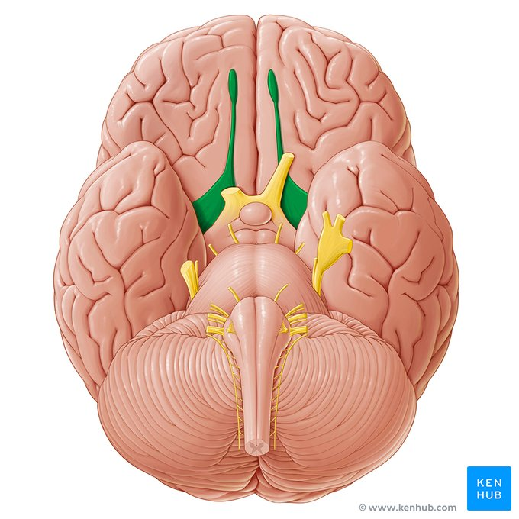
Olfactory nerve

Slide 29
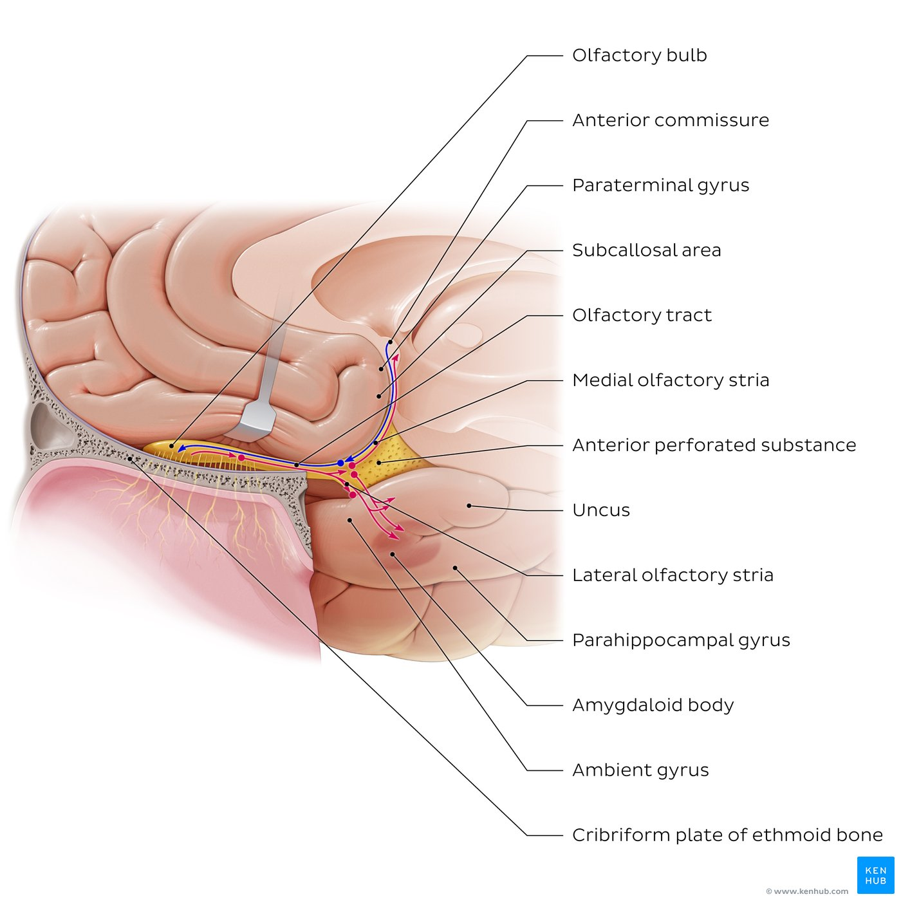
Olfactory pathway
Midsagittal section of the cerebrum and roof of the nasal cavity showing the olfactory structures.
The olfactory nerve (CN I) arises from multiple olfactory sensory neurons in the olfactory mucosa whose central processes (axons) combine to form olfactory fiber bundles.
These fiber bundles pass through foramina in the cribriform plate (of ethmoid bone), terminating in the olfactory bulb.
The olfactory bulb extends caudally/posteriorly as the olfactory tract. This divides at the olfactory trigone into the medial/lateral olfactory striae which form the borders of the anterior perforated substance, and carry sensory information to regions of the olfactory cortex.

Slide 30
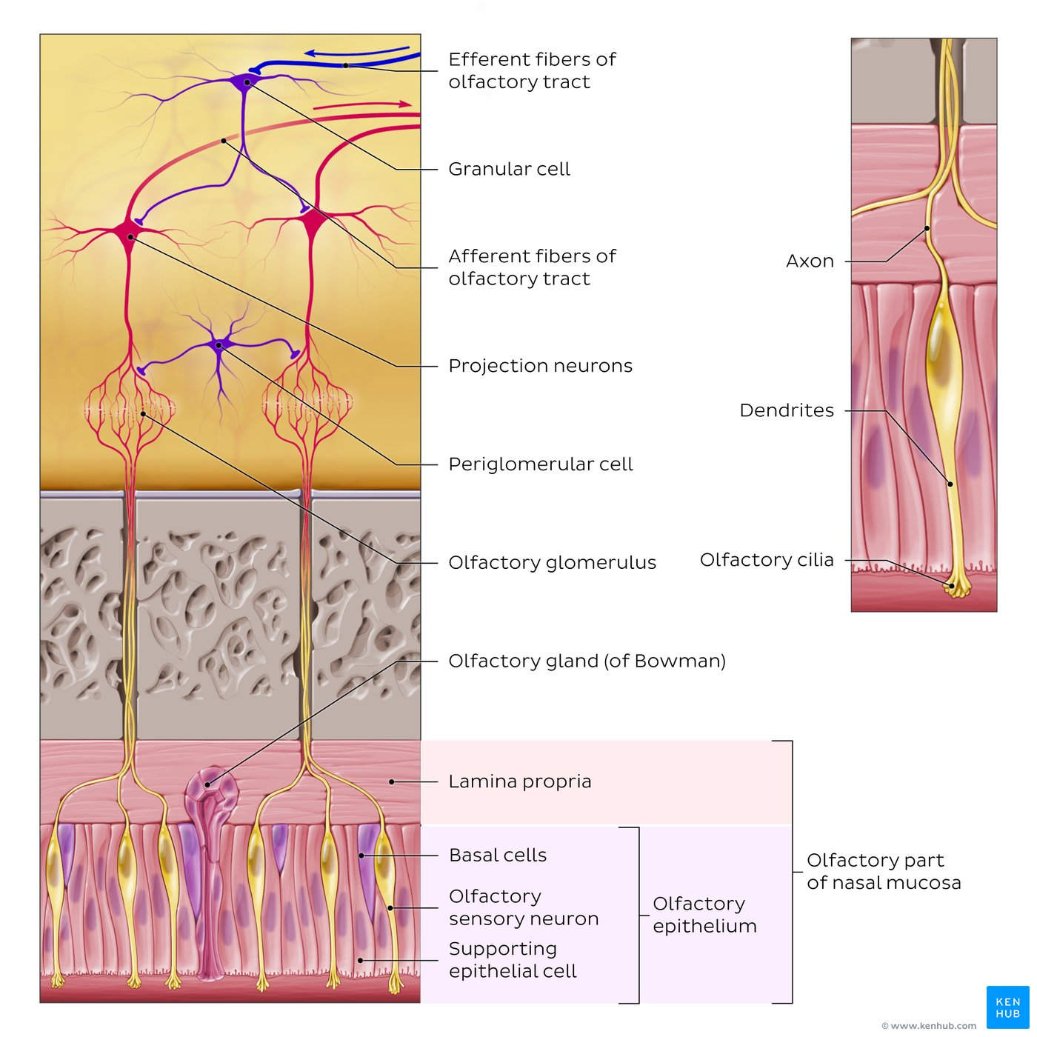
Olfactory organ and bulb
Section of nasal mucosa and cribriform plate, with a microscopic view of the olfactory organ (olfactory part of nasal mucosa) and neural pathways of the olfactory bulb.
The olfactory epithelium contains olfactory sensory neurons (olfactory receptor cells) that are wedged between supporting and basal epithelial cells.
The peripheral processes (dendrites) of each neuron bears dendritic bulbs (sometimes known as olfactory vesicles), with cilia protruding above the epithelial surface which react to odiferous stimuli dissolved with the nasal mucus.
The central processes (axons) of each olfactory neuron collect into olfactory fiber bundles (a.k.a. olfactory nerves proper) that pass through the cribriform plate and project into the olfactory bulb.
Underlying the olfactory epithelium is the lamina propria which contains olfactory glands (of Bowman) that span the olfactory epithelium and secrete mucus. The olfactory bulb contains about 2000 olfactory glomeruli formed by synapses between terminal ends of the olfactory fiber bundles and the primary dendrites of projection neurons (mitral and tufted cells) as well as periglomerular cells, which are involved in odor discrimination. The projection neurons in turn project their axons (afferent fibers) posteriorly/caudally to form the olfactory tract. The olfactory bulb contains [amacrine] granular cells which receive efferent fibers from central brain areas (as well as other mitral/tufted cells) and modulates the afferent signals from mitral/tufted cells.

Slide 31
Key points about the olfactory nerve and pathway
Olfactory organ | (Olfactory part of nasal mucosa) Epithelium: Olfactory sensory/receptor neurons (contain olfactory cilia), supporting cells, and basal (stem) cells Lamina propria: Olfactory glands (Bowman's glands)
Olfactory nerve | Cranial nerve I (CN I): Collective term for 15-20 olfactory fiber bundles which cross the cribriform plate on each side
Olfactory bulb | Contains olfactory glomeruli, cell bodies of projection neurons (mitral and tufted cells), granule cells, periglomerular cells; serves as a relay station of the olfactory pathway
Olfactory tract | Axons of projection neurons (afferent fibers of olfactory bulb) Anterior olfactory nucleus Efferent (centrifugal) fibers of olfactory bulb
Olfactory striae | Medial and lateral divisions of olfactory tract
Olfactory cortex | Medial olfactory stria: Subcallosal area, paraterminal gyrus, anterior commissure Lateral olfactory stria: Olfactory tubercle, piriform cortex, anterior cortical amygdaloid nucleus, periamygdaloid cortex, and lateral entorhinal cortex
Function/type of fibers | Smell/olfaction Special sensory/special visceral afferent

Slide 32
Function: special sense of smell (special visceral afferent)
Olfactory receptor neurons (in the olfactory part of the nasal mucosa) → olfactory nerves. Apical surfaces of olfactory neurons → olfactory cilia (stimulated by odorant gas molecules).
Emergence: cerebral hemispheres

Slide 33
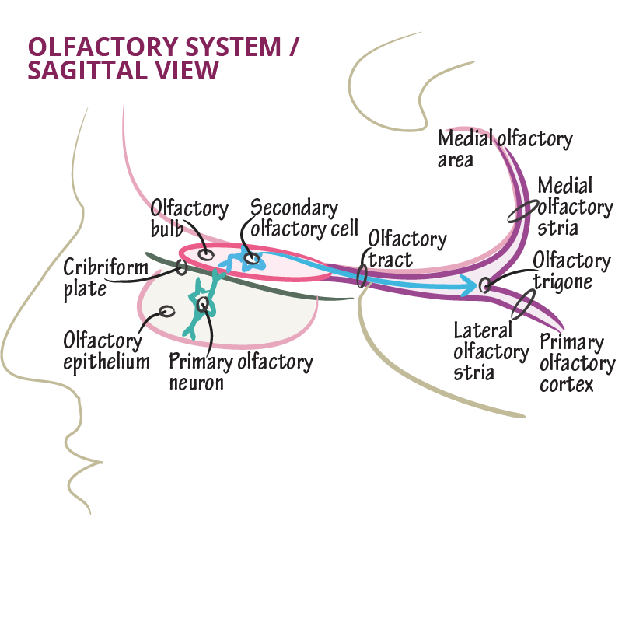
Course
olfactory filaments pass through the foramina of the cribriform plate of the ethmoid → olfactory bulb (anterior cranial fossa) → synapse with mitral cells → formation of the olfactory tract → division into medial and lateral olfactory striae
Lateral termination: projects to the piriform cortex of the anterior part of the temporal lobe
Medial termination: projects to contralateral olfactory structures via the anterior commissure

Slide 34
Lesion #1 — Anosmia-Loss of smell
Often due to upper respiratory infection, paranasal sinus disease, head trauma.
Loss of olfactory fibers with advancing age.
Associated loss of taste.
Examination: odor identification (e.g., coffee). Diagnostic clue for cerebrospinal fluid rhinorrhea and meningioma in the anterior lobe.
Olfactory bulb injury (filaments torn and severed) in ethmoid fracture → unilateral loss of smell → detachment of nerve fibers on one side.
Lesion #2 — Olfactory hallucinations
Temporal lobe lesions
Irritation of the olfactory cortex → temporal lobe epilepsy or “uncinate fits”
Phantom unpleasant smells and involuntary movements of lips/tongue

Slide 35
ΙΙ. Optic Nerve
Ι. Olfactory n.
ΙΙ. Optic n.
ΙΙΙ. Oculomotor n.
ΙV. Trochlear n.
V. Trigeminal n.
VI. Abducens n.
VII. Facial n.
VIII. Vestibulocochlear n.
ΙΧ. Glossopharyngeal n.
Χ. Vagus n.
ΧΙΙ. Hypoglossal n.
ΧΙ. Accessory n.

Slide 36
Optic nerve
The optic nerve (CN II) is a special somatic afferent (SSA) nerve which carries the sensation of sight (vision) from the retina of the eye to the brain. The optic nerve is a part of the visual pathway, which is a route by which light that falls on the retina is transmitted to the occipital lobe of the brain, where it is interpreted as visual information. The visual pathway refers to a series of synapses that start in the retina, where light stimuli are converted into action potentials, and transmitted across several nervous structures to reach the primary visual cortex.
The structures of the visual pathway include the retinal neurons (photoreceptors, bipolar cells, ganglion cells) which pass visual stimuli through the optic nerve, optic chiasm, and optic tract to the lateral geniculate nucleus. Axons from the lateral geniculate nucleus then project via the optic radiation to the primary visual cortex of the occipital lobe.
The optic nerve is formed when the axons of retinal ganglion cells pierce the scleral layer of the eyeball. The nerve runs posteromedially within the orbit and through the optic canal to enter the cranial cavity, where together with its contralateral counterpart, forms the optic chiasm.

Slide 37
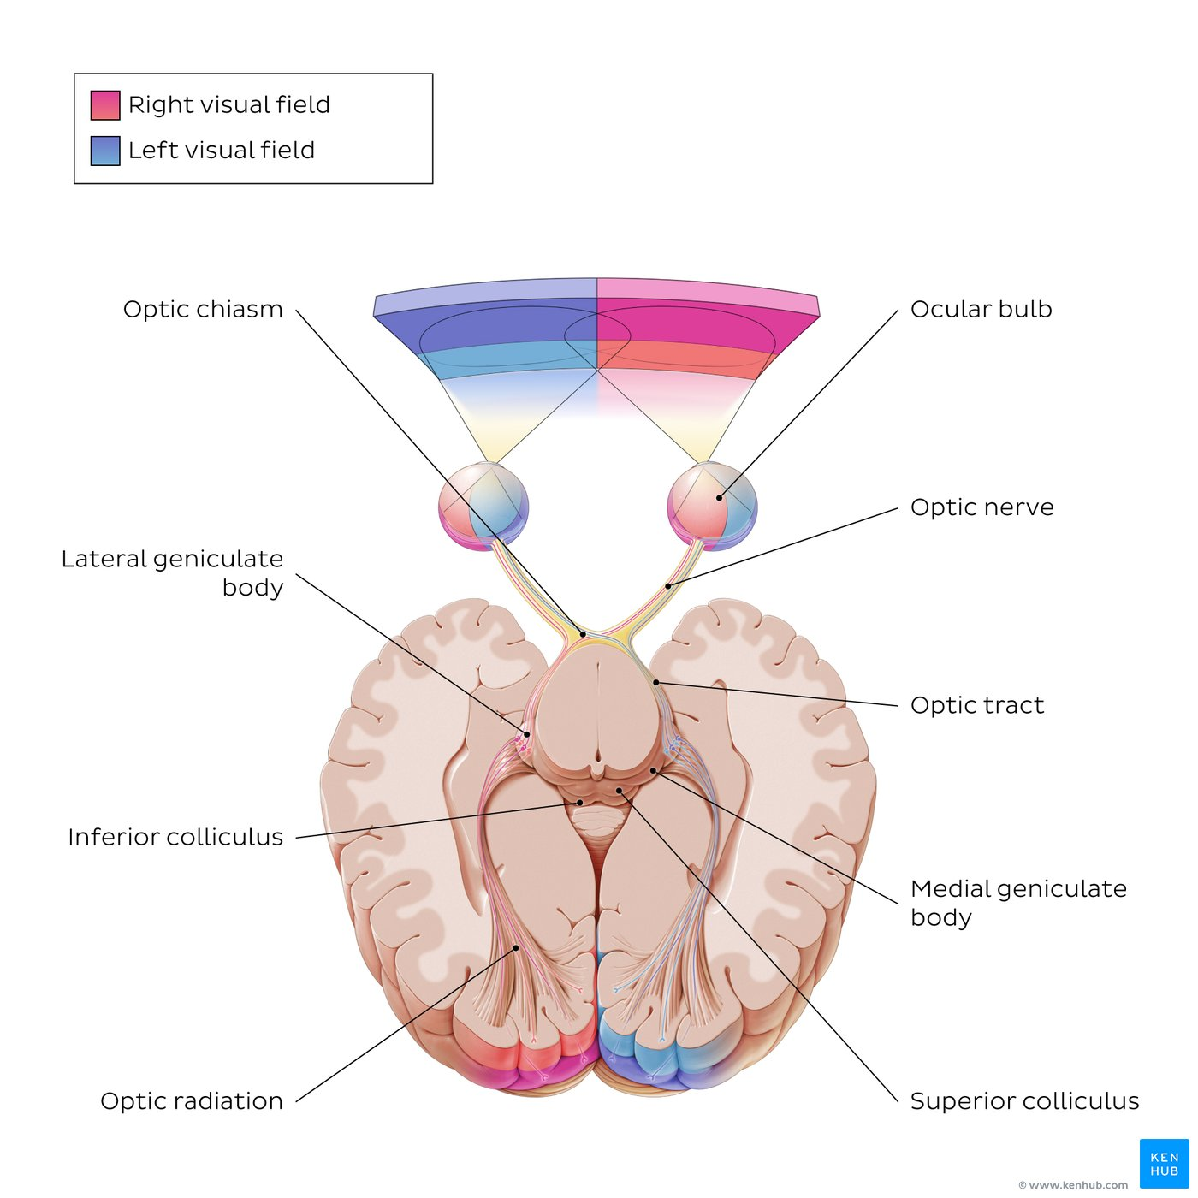
The components of the visual pathway
The visual pathway begins with light entering the ocular bulb from the visual fields and being processed by the retina. Visual information is then passed on from the retina by the optic nerve (CN II) through the optic canal (not shown) to the optic chiasm in the middle cranial fossa.
From the optic chiasm, the axons of the optic nerve continue posteriorly as the optic tract, which then synapse at the lateral geniculate nucleus of the thalamus.
Axons from the lateral geniculate nucleus travel via the optic radiation to finally reach the primary visual cortex. It is important to note that about 90% of the retinal axons synapse directly at the lateral geniculate nucleus.
The remaining 10% project to other subcortical nuclei, mainly the superior colliculus. The superior colliculus is involved in visual reflexes, such as saccadic eye movements or tracking of objects in the visual field. The superior colliculus projects onto the pulvinar of thalamus, which in turn projects onto the secondary visual cortex.

Slide 38
Key points about the visual pathway
Components | Retina → optic nerve (CN II) → optic chiasm → optic tract → lateral geniculate nucleus (90%) → optic radiation → primary visual cortex Retina → optic nerve (CN II) → optic chiasm → optic tract → superior colliculus (10%) → pulvinar of thalamus → secondary visual cortex
Retina | Sensory neural layer of the eyeball Neurons: Photoreceptors (rod cells and cone cells), bipolar cells, ganglion cells, horizontal cells, and amacrine cells
Optic nerve (CN II) | Formed by axons of ganglion cells coming together at the optic disc
Optic chiasm | Point of decussation of the optic nerves: nasal fibers of retina cross over to the contralateral optic tract, while temporal fibers stay on the same side (ipsilateral)
Optic tracts | Left: Carries left temporal and right nasal fibers of retina Right: Carries right temporal and left nasal fibers of retina
Lateral geniculate nucleus | Receives 90% of the retinal fibers Represents a relay center of the thalamus that projects to the primary visual cortex via the optic radiation
Superior colliculus | Receives 10% of the retinal fibers Integrates visual, auditory, and somatosensory spatial information and controls reflex movements of the eye
Optic radiation | Large bilateral bundle of fibers each containing two divisions that receive visual input from upper and lower quadrants of the contralateral hemifields
Primary visual cortex | Brodmann area 17 : Region of the occipital lobe that receives and processes visual information from contralateral visual field

Slide 39
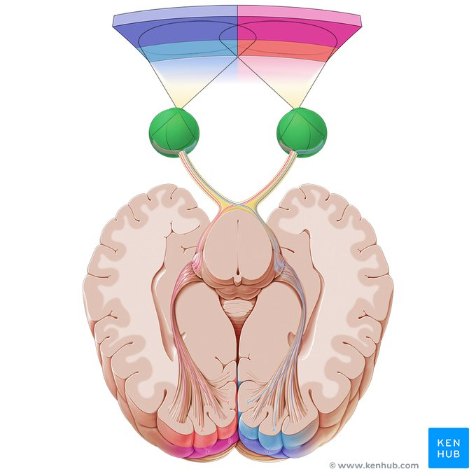
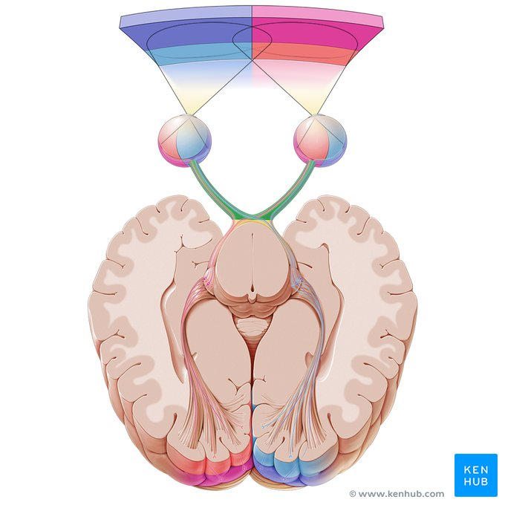
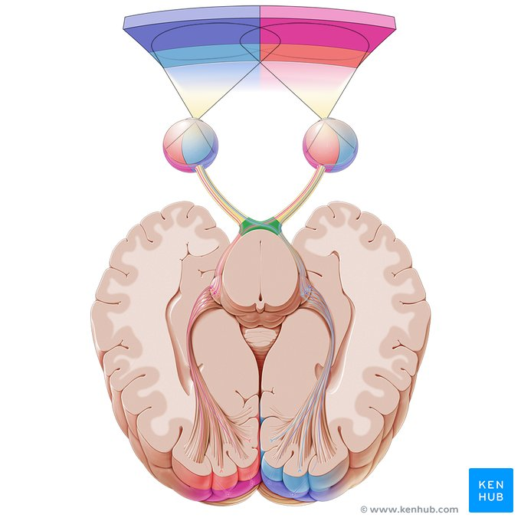

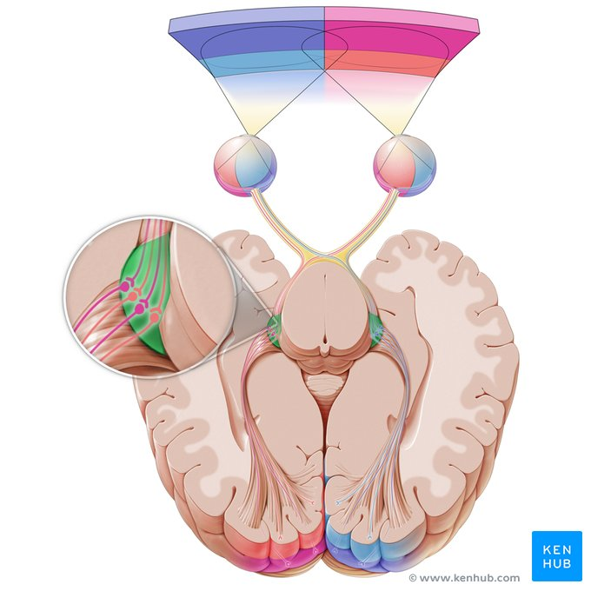
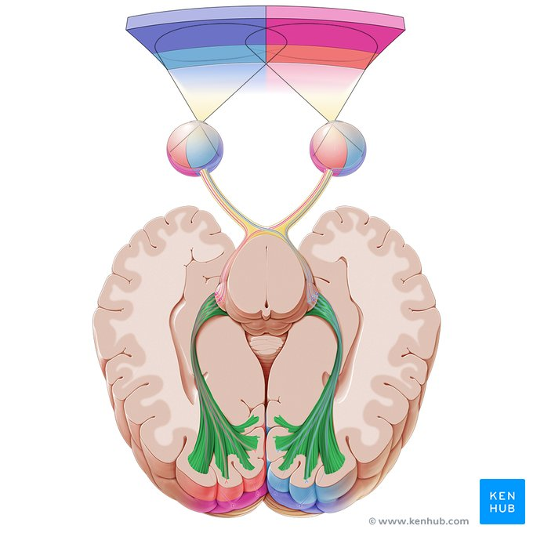
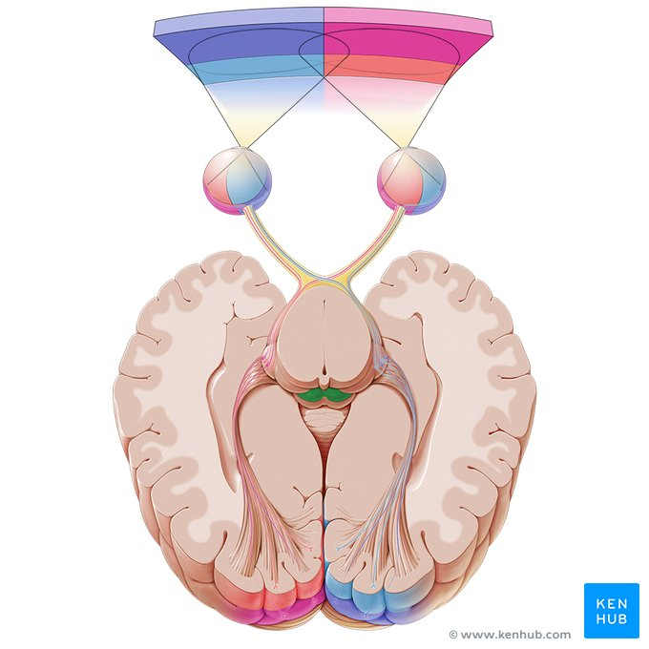
Ocular bulb, optic nerve, optic chiasm, optic tract, lateral geniculate body, optic radiation, superior colliculus

Slide 40
Function
special sense of vision (special visceral afferent)
Optic nerves: axons of retinal ganglion cells. Initially unmyelinated axons → they pierce the sclera → become myelinated behind the optic disc (optic papilla).
Emergence: diencephalon (interbrain)

Slide 41
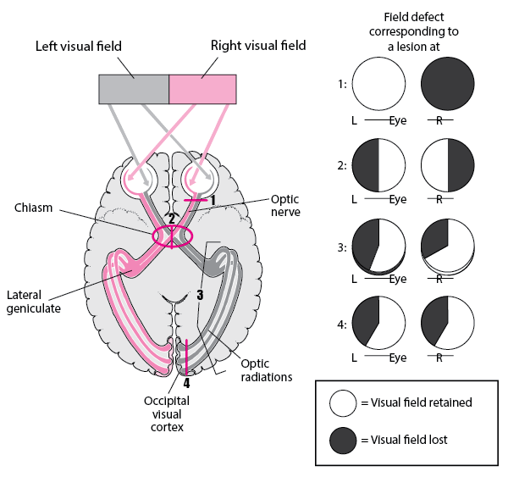
Course:
optic disc → optic canal (orbit) → optic chiasm (cranial cavity) → fibers cross at the chiasm and join uncrossed fibers from the temporally-sited retina → form optic tract → lateral geniculate bodies of the thalamus → visual cortices of the occipital lobes

Slide 42
Lesion #1: Demyelinating diseases
Primarily oligodendrocytes (not Schwann cells).
Remaining peripheral/cranial nerves are mainly Schwann-cell myelinated.
Optic nerves are particularly susceptible to CNS demyelinating diseases such as multiple sclerosis (these usually do not affect the rest of the peripheral nerves).
Lesion #2: Optic neuritis
Reduction of visual acuity, with or without changes in peripheral visual fields.
Due to inflammatory, degenerative, demyelinating or toxic disorders.
Toxins: methanol and ethanol, tobacco, Pb, Hg.
Pale and smaller optic disc.

Slide 43
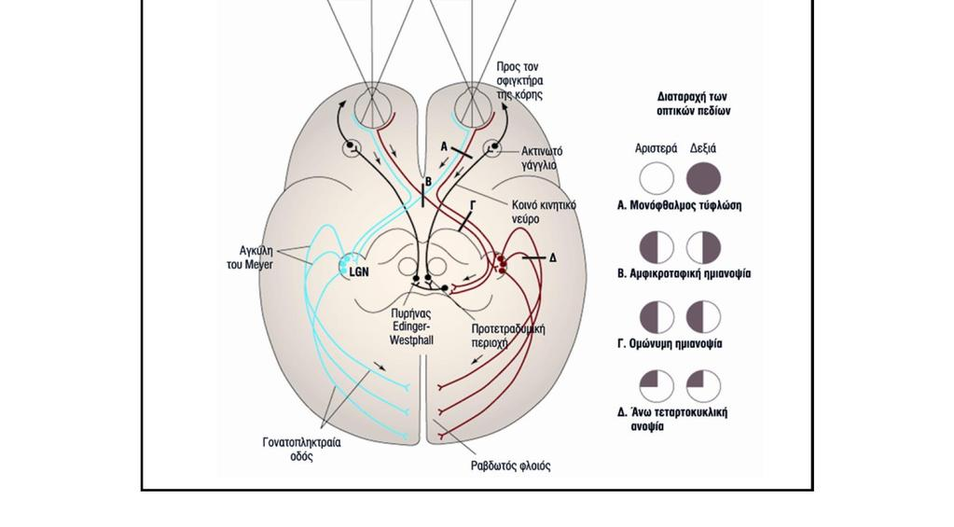
Lesion #3: Visual field defects
A. Complete lesion of optic nerve: blindness in nasal (medial) and temporal (lateral) fields, ipsilateral.
B. Complete lesion of optic chiasm: bitemporal hemianopia — loss of temporal visual fields bilaterally.
C. Complete lesion of right optic tract (in the midline): blindness of left temporal and right nasal fields.

Slide 44
Movements of the eyeball
They are controlled by three cranial nerves:
the oculomotor (CN III), trochlear (CN IV) and abducens (CN VI) nerves.
These nerves provide motor supply to the extraocular muscles:
Oculomotor nerve: superior, medial and inferior recti muscles, as well as the inferior oblique muscle.
Trochlear nerve: superior oblique muscle (‘trochlear’ referring to the pulley-like anatomy of this muscle (Latin: trochlea = pulley).
Abducens nerve: lateral rectus (‘abducens’ refers to abduction of the eye which is achieved by this muscle).
In addition, the oculomotor nerve also provides motor innervation to the levator palpebrae superioris muscle, as well as parasympathetic innervation to the sphincter pupillae and ciliary muscles. Therefore, it also has a role in elevation of the upper eyelid, pupillary constriction and accommodation of the lens.

Slide 45
ΙΙΙ. Oculomotor Nerve
Ι. Olfactory n.
ΙΙ. Optic n.
ΙΙΙ. Oculomotor n.
ΙV. Trochlear n.
V. Trigeminal n.
VI. Abducens n.
VII. Facial n.
VIII. Vestibulocochlear n.
ΙΧ. Glossopharyngeal n.
Χ. Vagus n.
ΧΙΙ. Hypoglossal n.
ΧΙ. Accessory n.

Slide 46
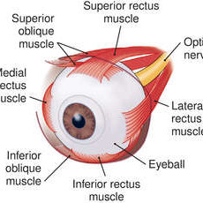
Function
Innervation of superior, medial, inferior rectus and inferior oblique muscles (4 of 6 extraocular muscles) and levator palpebrae superioris.
Proprioception for those muscles.
Parasympathetic innervation (via the ciliary ganglion) of the smooth muscle of the pupil sphincter and the ciliary muscle.
Nuclei
somatic motor nucleus of CN III
parasympathetic Edinger–Westphal nucleus

Slide 47
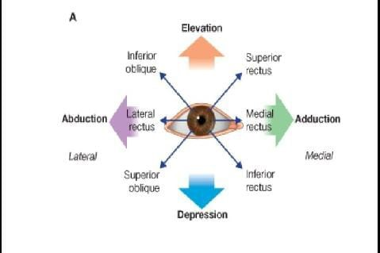
Eye Movements
Lateral rectus (VI)
Medial rectus (III)
Superior rectus (III)
Inferior rectus (III)
Inferior oblique (III)
Superior oblique (IV)

Slide 48
Emergence: Midbrain
Course:
midbrain → penetrates the dura mater, passing above the diaphragma sellae → roof of cavernous sinus → superior orbital fissure → divides into superior and inferior branches.
Superior branch:
innervates superior rectus and levator palpebrae superioris
Inferior branch:
innervates inferior rectus, medial rectus and inferior oblique
Preganglionic sympathetic fibers to the ciliary (ocular) ganglion

Slide 49
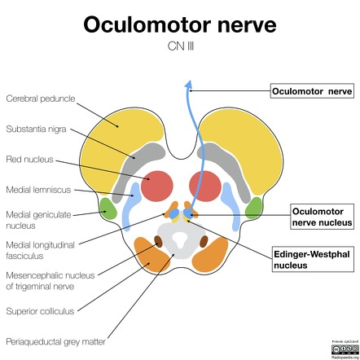

Slide 50
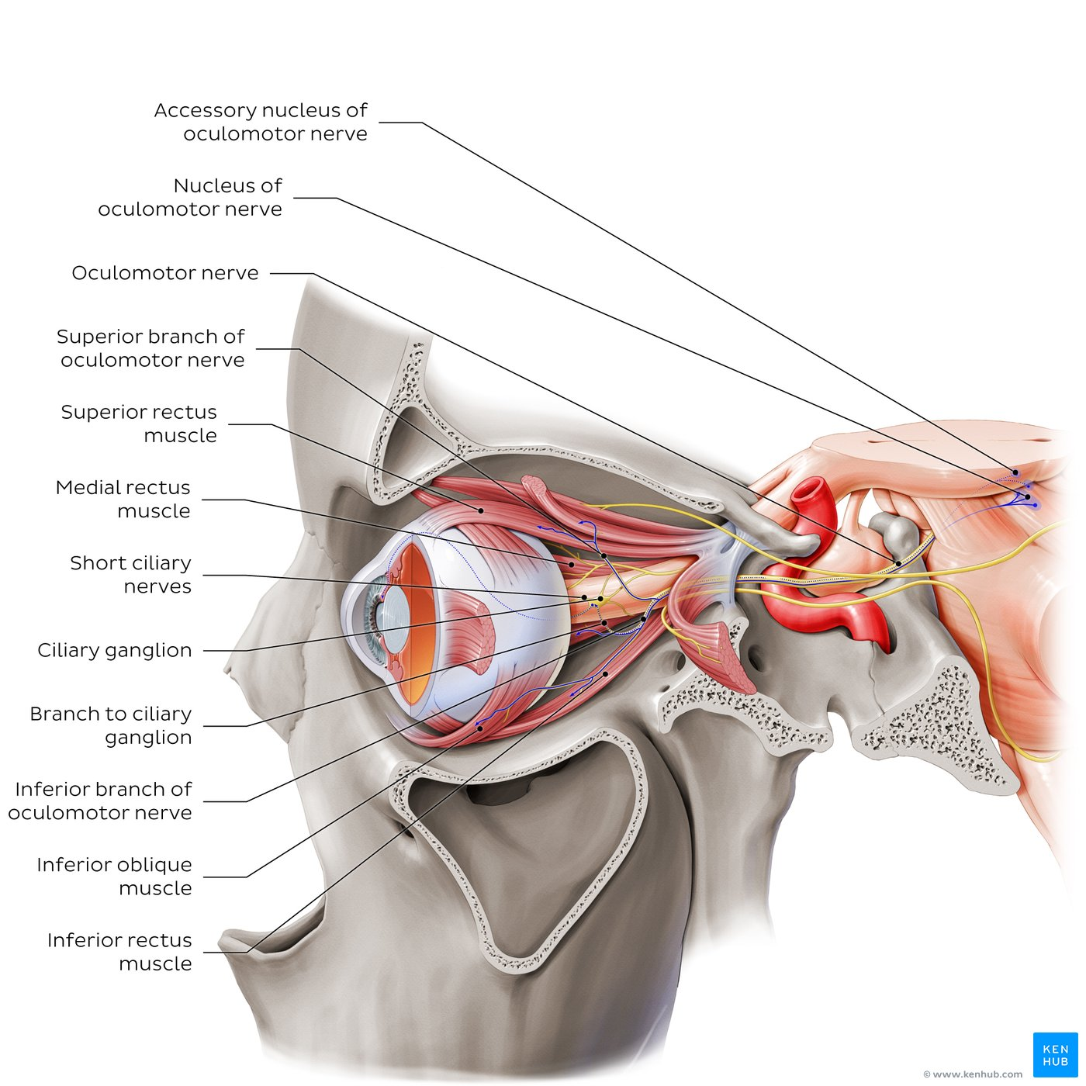
Oculomotor nerve
The oculomotor nerve (CN III) arises from the oculomotor complex located in the midbrain at the level of the superior colliculus.
It is comprised of two nuclei: the nucleus of oculomotor nerve (contains cell bodies of general somatic efferent (GSE, motor) neurons), and the accessory nucleus of oculomotor nerve (Edinger-Westphal, contains cell bodies of general visceral efferent (GVE, parasympathetic) neurons).
From here, it enters the orbit via the superior orbital fissure as two branches which innervate the majority of the extraocular muscles:
- Superior branch: superior rectus and levator palpebrae superioris muscles.
- Inferior branch: medial rectus, inferior rectus and inferior oblique muscles.
The inferior branch also carries preganglionic parasympathetic fibers which synapse with postganglionic neurons in the ciliary ganglion; these fibers provide parasympathetic innervation to the ciliary and sphincter pupillae muscles responsible for accommodation and pupillary constriction, via the short ciliary nerves (branch of CN V1).

Slide 51
Lesion #1: Compression of the oculomotor nerve
Raised intracranial pressure
compression of CN III against the ridge of the petrous temporal bone
pupil dilation (mydriasis).
Ipsilateral sluggish pupillary light reflex.
Lesion #2: Aneurysm of the posterior cerebral or superior cerebellar artery
Compression on CN III as it passes between vessels.
Cavernous sinus lesions or infections can also affect CN III.

Slide 52
ΙV. Trochlear Nerve
Ι. Olfactory n.
ΙΙ. Optic n.
ΙΙΙ. Oculomotor n.
ΙV. Trochlear n.
V. Trigeminal n.
VI. Abducens n.
VII. Facial n.
VIII. Vestibulocochlear n.
ΙΧ. Glossopharyngeal n.
Χ. Vagus n.
ΧΙΙ. Hypoglossal n.
ΧΙ. Accessory n.

Slide 53
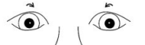
Function: innervation of superior oblique muscle
Nucleus: trochlear nerve nucleus (caudal to oculomotor nucleus in the midbrain)
all nerve with the longest intracranial (subarachnoid) course of all cranial nerves.

Slide 54
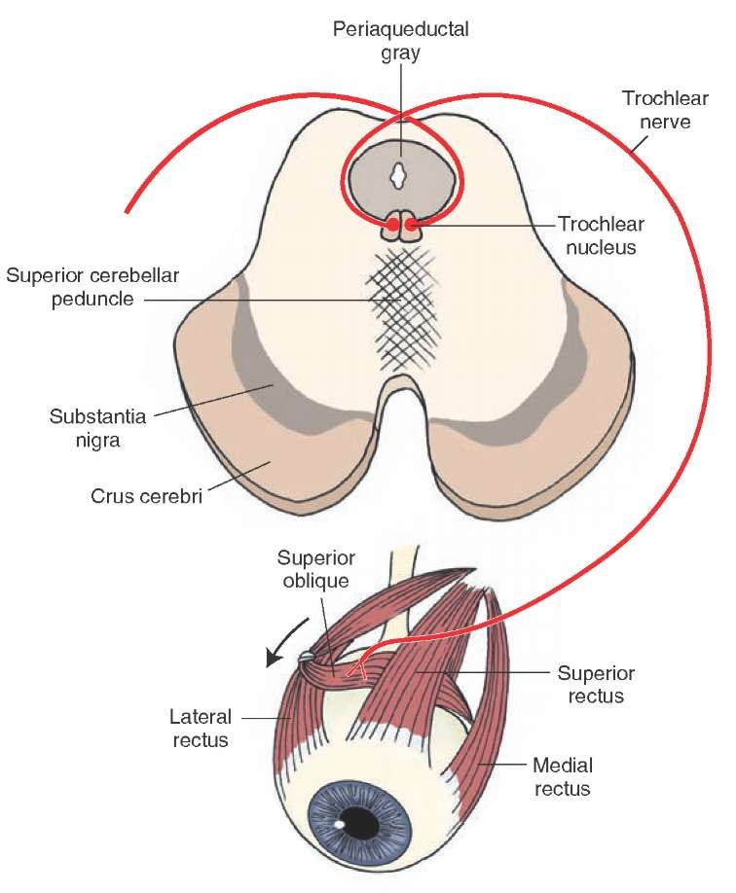
Emergence: midbrain (dorsally)
Course:
dorsal midbrain surface → around the brainstem → pierces the dura at the free edge of the tentorium cerebelli → lateral wall of cavernous sinus → superior orbital fissure → orbit (note: the only cranial nerve that emerges dorsally)

Slide 55
Lesions
Rare as an isolated palsy.
Long intracranial course → vulnerable to stretch with raised intracranial pressure → trochlear nerve transection
diplopia (double vision), especially when looking down.
Normally the superior oblique assists the inferior rectus when the eye is adducted.
Compensatory head tilt to the opposite side of the lesion reduces diplopia.

Slide 56
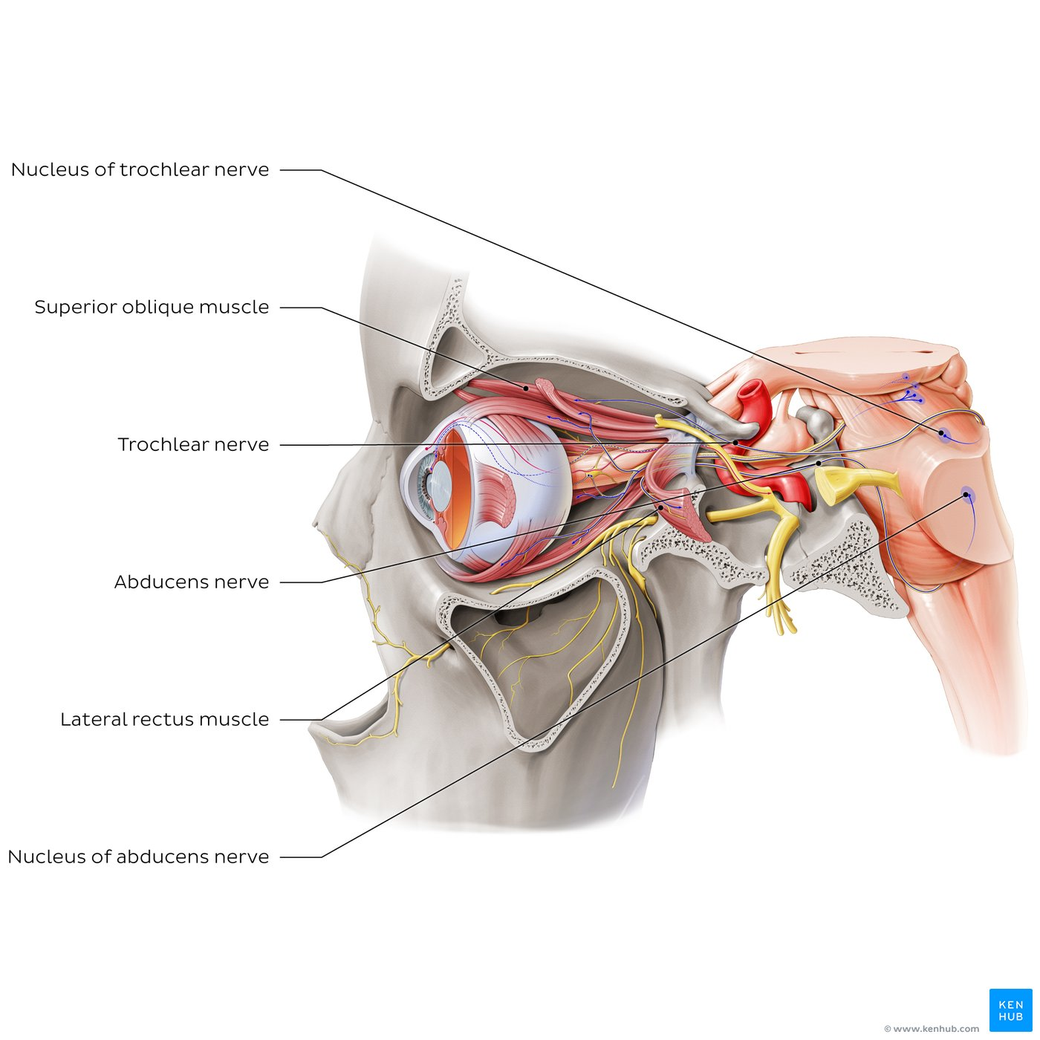
Trochlear and abducens nerves
The trochlear nerve (CN IV) arises from the nucleus of trochlear nerve (containing general somatic efferent (GSE) neurons), which is located in the caudal midbrain. From here, the trochlear nerve curves around the midbrain, passing through the lateral wall of the cavernous sinus, superior and lateral to the oculomotor nerve. It continues into the orbit via the superior orbital fissure, external to the common tendinous ring, before terminating in the superior oblique muscle.
The abducens nerve (CN VI) arises from the nucleus of abducens nerve, which also contains general somatic efferent (GSE) neurons and is located near the rhomboid fossa/floor of the fourth ventricle. Fibers from this nucleus exit the brainstem at the medullopontine sulcus (pontomedullary junction) as the abducens nerve, which courses through the cavernous sinus (along the internal carotid artery). It then enters the orbit via the superior orbital fissure. The abducens nerve then penetrates the medial surface of the lateral rectus muscle, which functions as an abductor of the eyeball.

Slide 57
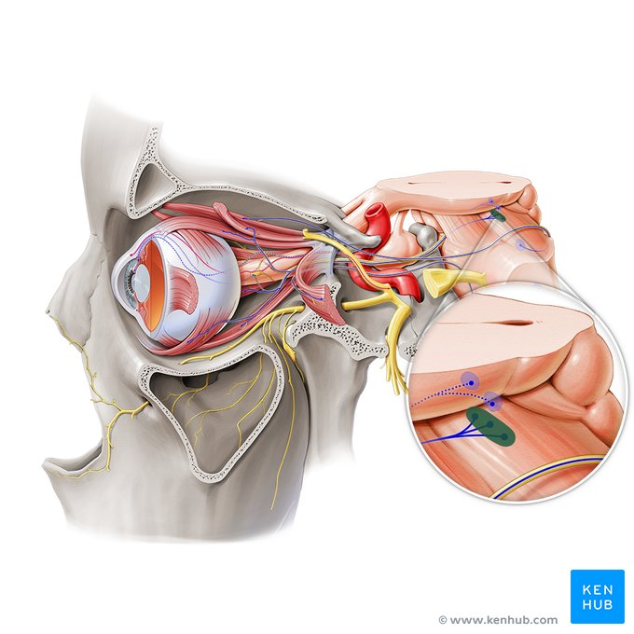
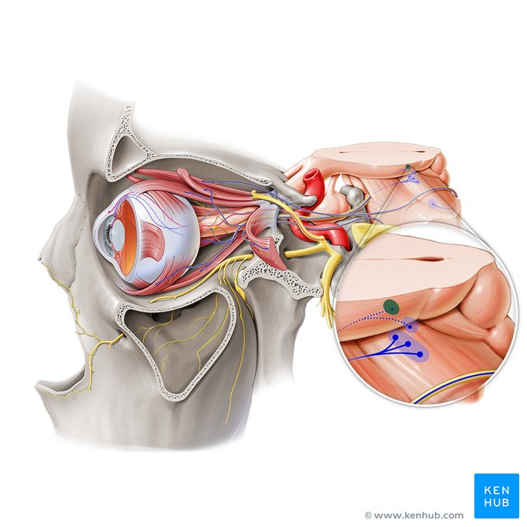
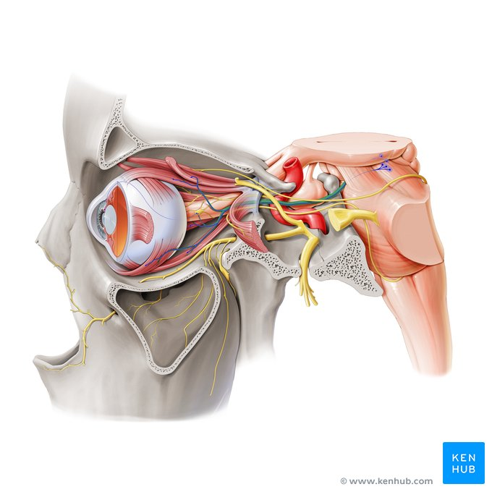



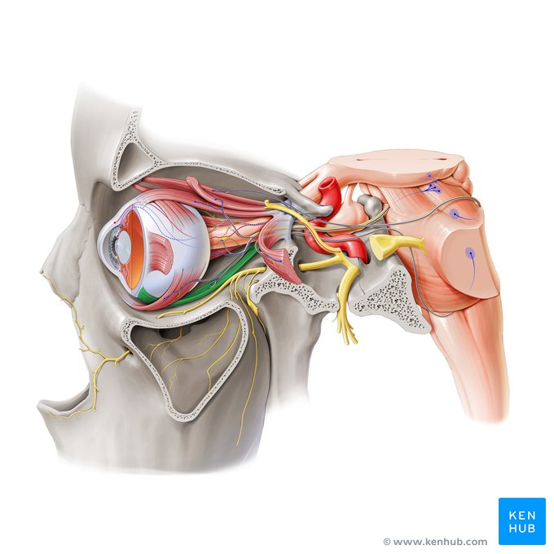

Nucleus of oculomotor nerve, accessory nucleus of oculomotor nerve, oculomotor nerve, superior rectus muscle, levator palpebrae superioris muscle, medial rectus muscle, inferior rectus muscle, inferior oblique muscle

Slide 58
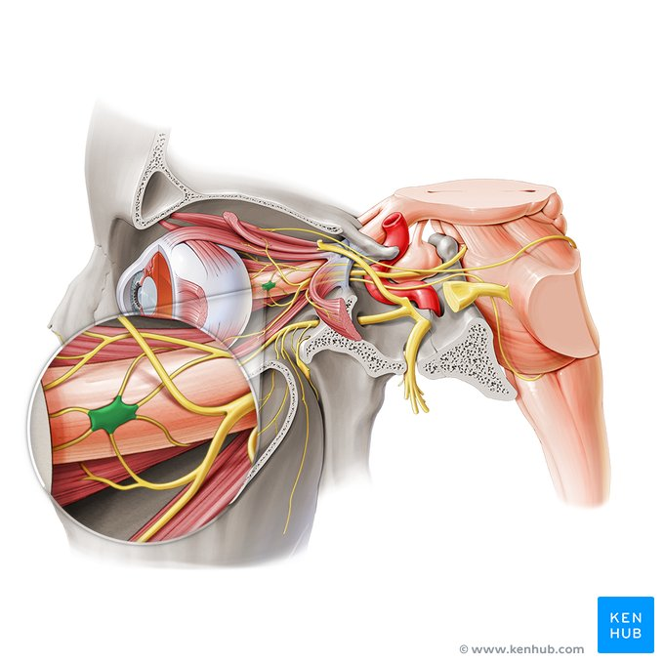
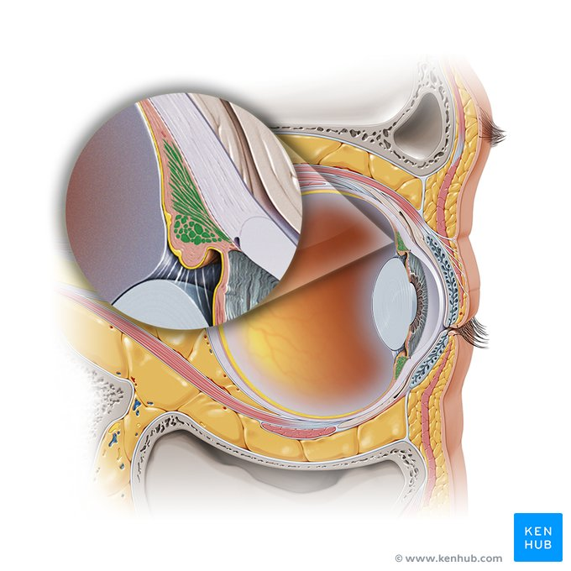
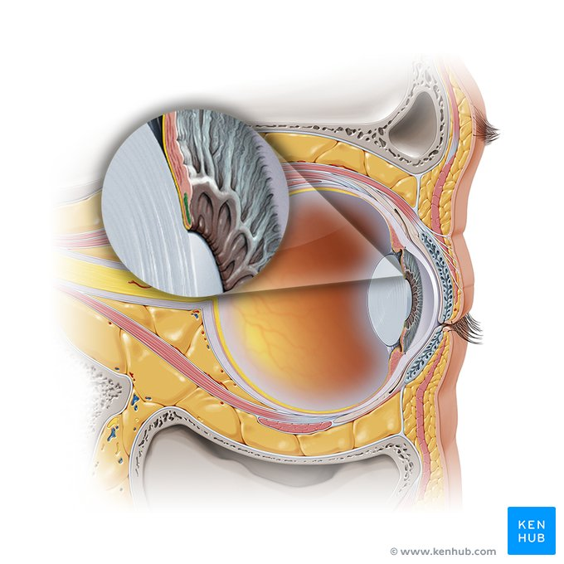
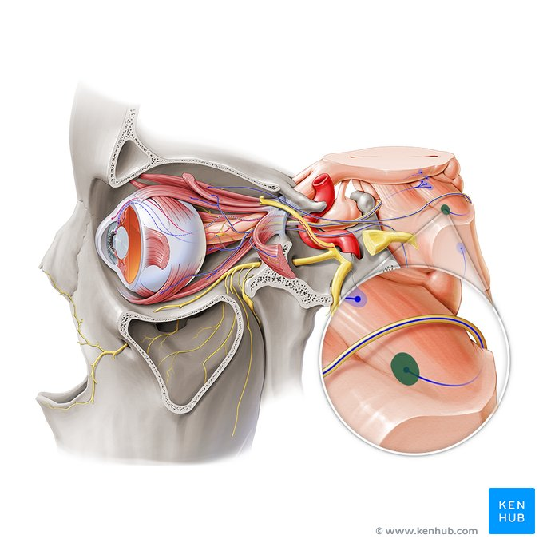


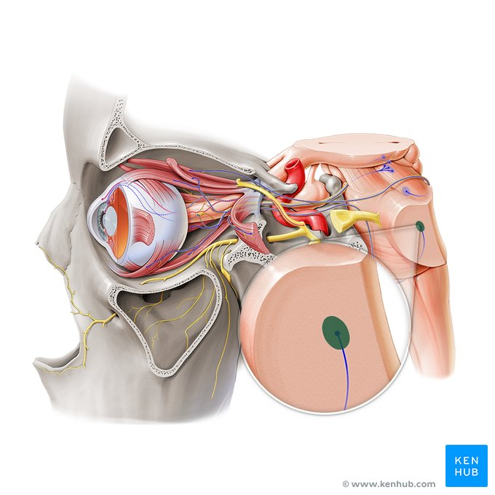

Ciliary ganglion, ciliary muscle, sphincter pupillae of iris, nucleus trochlear nerve, trochlear nerve, superior oblique muscle, nucleus of abducens nerve, abducens nerve

Slide 59
Key points about the cranial nerves III, IV and VI
Oculomotor nerve (CN III) | Fiber types: General somatic efferent fibers (GSE), general visceral efferent fibers (GVE) Origin: Ventral midbrain (interpeduncular fossa) Exits skull: Superior orbital fissure Nuclei: Nucleus of oculomotor nerve (GSE); accessory nucleus of oculomotor nerve (Edinger-Westphal) (GVE) Branches: Superior and inferior branch, branch of oculomotor nerve to ciliary ganglion (parasympathetic root of ciliary ganglion) Function: Superior branch → Motor innervation to superior rectus, levator palpebrae superioris muscles Inferior branch → medial rectus, inferior rectus, inferior oblique muscles (GSE); branch to ciliary ganglion → parasympathetic innervation to ciliary and sphincter pupillae muscles (GVE)
Trochlear nerve (CN IV) | Fiber type: General somatic efferent (GSE) Origin: Dorsal midbrain Exits skull: Superior orbital fissure Nucleus: Nucleus of trochlear nerve Function: Motor innervation to superior oblique muscle
Abducens nerve (CN VI) | Fiber type: General somatic efferent fibers (GSE) Origin: Medullopontine sulcus (pontomedullary junction) Exits skull: Superior orbital fissure Nucleus: Nucleus of abducens nerve Function: Motor innervation to lateral rectus muscle

Slide 60
V. Trigeminal Nerve
Ι. Olfactory n.
ΙΙ. Optic n.
ΙΙΙ. Oculomotor n.
ΙV. Trochlear n.
V. Trigeminal n.
VI. Abducens n.
VII. Facial n.
VIII. Vestibulocochlear n.
ΙΧ. Glossopharyngeal n.
Χ. Vagus n.
ΧΙΙ. Hypoglossal n.
ΧΙ. Accessory n.

Slide 61
Trigeminal nerve - 1st Division
The trigeminal nerve, otherwise known as the 5th cranial nerve (CN V), is a mixed nerve meaning that it is made up of both sensory and motor components. It is formed by three sensory nuclei (mesencephalic/principal sensory/spinal nucleus of trigeminal nerve) and one motor nucleus (motor nucleus of trigeminal nerve). These roots course anteriorly out of the posterior cranial fossa and travel along the anterior surface of the petrous part of the temporal bone where the sensory root expands to form the trigeminal ganglion, from which arises the three divisions of the trigeminal nerve: the ophthalmic (V1), maxillary (V2) and mandibular nerves (V3).
The ophthalmic nerve is the most superior branch of the trigeminal ganglion, and provides general somatic afferent (GSA) innervation to structures of the upper portion of the face, nasal cavity and mucosa of paranasal sinuses. It extends from the trigeminal ganglion through the lateral wall of the cavernous sinus where it divides into three main branches (the lacrimal, frontal and nasociliary nerves) all of which pass through the superior orbital fissure.

Slide 62
Function
General sensory (1st and 2nd divisions) and general motor (3rd division)
Nuclei
one motor nucleus (motor nucleus of trigeminal) and three sensory nuclei (mesencephalic, principal sensory, and spinal trigeminal nucleus)
Emergence
brainstem
Course (Before Branching)
lateral surface of pons → formation of trigeminal (semilunar) ganglion in Meckel’s cave (from sensory fibers*) → branching
*Motor root fibers bypass the ganglion by passing beneath it.

Slide 63
V1 Opthalmic
V2 Maxillary
V3 Mandibular
Via Superior orbital fissure
Via Foramen rotundum
via Foramen ovale
innervates cornea, superior conjunctiva, mucosa of the anterior/superior nasal cavity, frontal sinus and ethmoidal cells, dura of anterior and supratentorial cranial fossa, skin of the dorsum of the nose, upper eyelid, forehead and scalp.
innervates the dura of the middle cranial fossa, conjunctiva of lower eyelid, mucosa of nasal cavity, maxillary sinus, palate and upper gingiva, and skin of lateral side of external nose, lower eyelid, cheek and upper lip.
Sensory: mucosa of the anterior two-thirds of the tongue, floor of mouth, lower lip, teeth of lower jaw, external ear and skin of cheek, parotid and temporal regions.
Motor: innervation of muscles of mastication, mylohyoid, anterior belly of digastric, tensor veli palatini, tensor tympani.
Lacrimal (with communicating to zygomatic
Frontal
Supraconchoidal
Supratrochlear
Ophthalmorinal
Ophthalmic ganglion sensory root
Short radial nerves
Long radial nerves
Subtrochlear
Anterior/posterior ethmoid
Infraorbital
Internal/external nasal branches
Inferior palpebral
Upper/lower labial
Posterior superior alveolar
Zygomatic
Zygomaticotemporal/parietal
Lacrimal palindromic
Ganglionic branches
Anterior/medial superior alveolar
Purely motor branches
(for masseter, pterygoid, temporal, tensor tympani, tensor soft palate)
Ototemporal
Glossary
Inferior alveolar
Genital nerve and (muscles) anterior gastrocnemius digastric and maxillohyoid Bycanetic

Slide 64
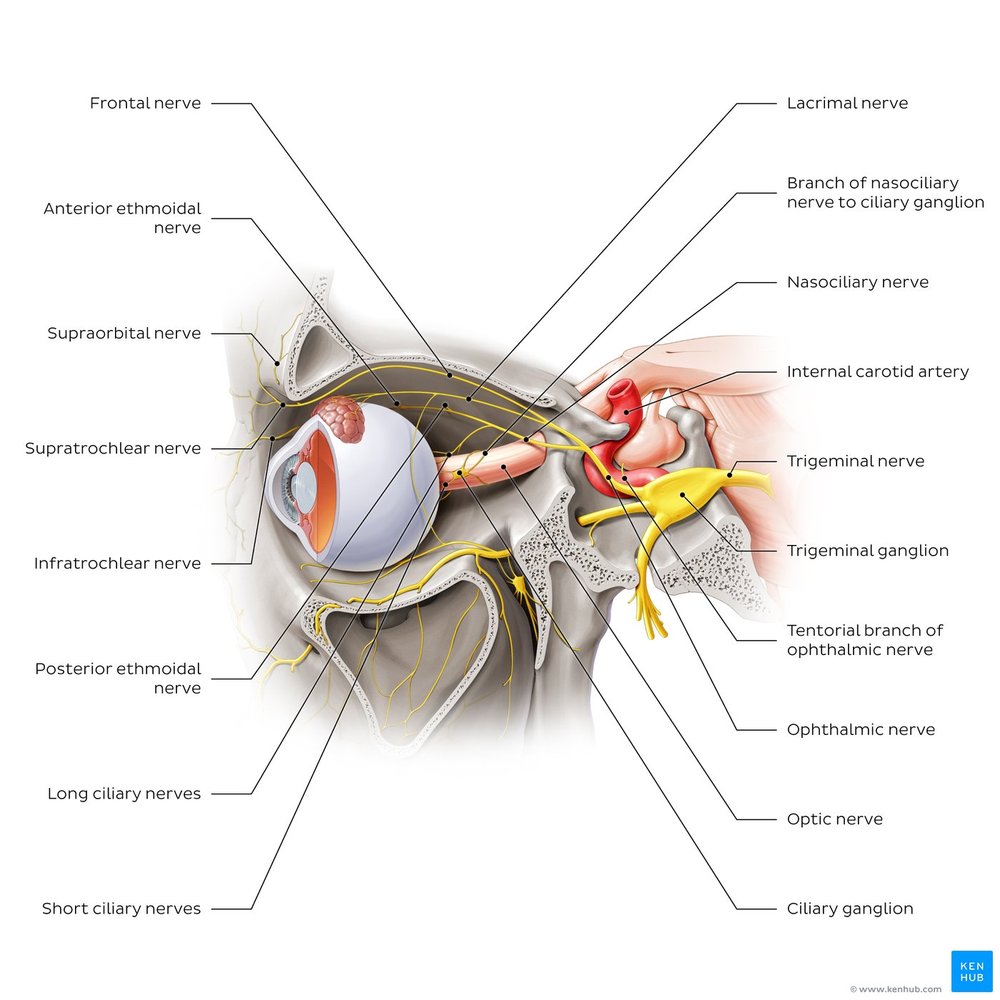
Ophthalmic nerve (Left lateral view)
The ophthalmic nerve extends from the trigeminal ganglion and gives rise to a small branch known as the tentorial branch of ophthalmic nerve which provides innervation to the tentorium cerebelli.
The frontal nerve is the largest branch of the ophthalmic nerve. It enters the orbit via the superior orbital fissure and divides into two terminal branches: the supraorbital and supratrochlear nerves.
The lacrimal nerve also enters the orbit external to the common tendinous ring and extends across the roof of the orbit towards the lacrimal gland. Before reaching the gland, it expands into several branches, which either terminate in the lacrimal gland or extend through the gland, terminating in the skin of the upper eyelid. Just behind the lacrimal gland, the lacrimal nerve is joined by the communicating branch of the zygomaticotemporal nerve (from V2) to lacrimal nerve, which provides parasympathetic innervation to the lacrimal gland.
The nasociliary nerve enters the superior orbital fissure within the common tendinous ring and then crosses over to the medial orbital wall. It gives off several branches which include the long ciliary, posterior ethmoidal, anterior ethmoidal and infratrochlear nerves as well as the branch of nasociliary nerve to ciliary ganglion (sensory root of ciliary ganglion).

Slide 65


Slide 66







Sensory root of trigeminal nerve, trigeminal ganglion, ophthalmic nerve, frontal nerve, supraorbital nerve, supratrochlear nerve, lacrimal nerve, ciliary ganglion

Slide 67
Key points about the ophthalmic nerve
Structure and features | Fibers: General somatic afferent (GSA) Origin: Trigeminal ganglion Exits skull: Superior orbital fissure Associated nuclei: Sensory nuclei (mesencephalic, principal sensory, spinal nuclei of trigeminal nerve) and motor nucleus of trigeminal nerve Associated ganglia: Trigeminal ganglion, ciliary ganglion
Branches | Frontal nerve (supraorbital and supratrochlear nerves) Lacrimal nerve Nasociliary nerve (branch of nasociliary nerve to ciliary ganglion, long ciliary nerves, posterior ethmoidal nerve, anterior ethmoidal nerve, infratrochlear nerve)
Function | Provides Innervation to forehead, scalp, eyelids, eye, conjunctiva and nasal cavity

Slide 68

Trigeminal nerve – 2nd Division
The maxillary nerve emerges from the anterior portion of the trigeminal ganglion and like its origin, is exclusively composed of general somatic afferent (sensory) fibers. It passes through foramen rotundum to enter the pterygopalatine fossa. Here, it gives rise to the majority of its branches before extending through the inferior orbital fissure where it gives rise to its terminal branch, the infraorbital nerve. Through its intricate pathway the maxillary nerve provides the major sensory innervation to the skin of the lower eyelid, the prominence of the cheek, part of the temporal region, alar part of the nose, and upper lip.
Just before the maxillary nerve exits the middle cranial fossa, via the foramen rotundum, it gives off a small meningeal branch which carries sensory impulses from the dura mater of this region. Within the pterygopalatine fossa, the maxillary nerve gives off a number of branches that can be divided into those which arise directly from the nerve and those associated with the pterygopalatine ganglion. The maxillary nerve leaves the pterygopalatine fossa to enter the infratemporal fossa, where it gives off the posterior superior alveolar nerve. It then turns medially to enter the orbit via the inferior orbital fissure, where it continues as the terminal branch of the maxillary nerve, the infraorbital nerve. The infraorbital nerve proceeds anteriorly across the floor of the orbit in the infraorbital groove, giving off the middle superior alveolar nerve, before continuing through the infraorbital canal. Here, the anterior superior alveolar nerve arises before the infraorbital nerve continues onto the face via the infraorbital foramen and terminates as groups of palpebral, nasal and superior labial branches.

Slide 69

Maxillary nerve (pterygopalatine fossa)
Within the pterygopalatine fossa, branches arise directly from the maxillary nerve including the branches to pterygopalatine ganglion and the zygomatic nerve.
Branches associated with the pterygopalatine ganglion include the nasopalatine, posterior superior nasal, greater palatine, lesser palatine and pharyngeal nerves, as well as 2-3 small orbital branches.
Parasympathetic and sympathetic fibers are delivered to the pterygopalatine ganglion via the nerve of pterygoid canal (derived from the greater petrosal (facial nerve, CN VII) and deep petrosal nerve (internal carotid plexus), respectively. Postganglionic fibers are then distributed within the aforementioned ganglionic branches of the maxillary nerve to regulate secretomotor and vascular responses in the lacrimal gland as well as mucous membranes of the nasal cavity, naso/oropharynx, and upper oral cavity.
While the naso-, greater and lesser palatine nerves mainly convey sensory impulses, they also carry special visceral afferent (taste) fibers from the palate to the pterygopalatine ganglion; these fibers continue to the facial nerve via the nerve of pterygoid canal.

Slide 70








Trigeminal ganglion, maxillary nerve, zygomatic nerve, pterygopalatine ganglion, nasopalatine nerve, posterior superior alveolar nerve, infraorbital nerve, superior dental plexus

Slide 71
Key points about the maxillary nerve
Structure and features | Fibers: General somatic afferent (GSA) Origin: Trigeminal ganglion Exits skull: Foramen rotundum Associated nuclei: Sensory nuclei (mesencephalic, principal sensory, spinal nuclei of trigeminal nerve) and motor nucleus of trigeminal nerve Associated ganglia: Trigeminal ganglion, pterygopalatine ganglion
Branches | Directly from maxillary nerve: Meningeal branch, branches of the maxillary nerve to pterygopalatine ganglion, zygomatic nerve, posterior superior alveolar nerve, infraorbital nerve Associated with pterygopalatine ganglion: Orbital branches, posterior superior nasal branches, nasopalatine nerve, pharyngeal nerve, greater palatine nerve, lesser palatine nerves
Function | Sensory innervation of skin of lower eyelid, prominence of the cheek, part of the temporal region, alar part of the nose and upper lip

Slide 72
Trigeminal nerve – 3rd Division
The mandibular nerve, accompanied by the motor root of the trigeminal nerve, leaves the skull through the foramen ovale, after which both unite within the infratemporal fossa. The mandibular nerve is therefore the only division of the trigeminal nerve to convey both afferent (sensory) and efferent (motor) nerve fibers. It supplies:
General somatic afferent (GSA, sensory) innervation to the skin over the mandible, cheek and temporal region, mucosa of the oral cavity and tongue, the mandibular teeth, parts of the external ear, as well as the temporomandibular joint.
Special visceral efferent (SVE) innervation is provided to eight muscles: muscles of mastication (4), mylohyoid, anterior belly of digastric, tensor veli palatini, and tensor tympani muscles.
Other fiber types (special visceral afferent (SVA), general visceral efferent (GVE)) are also carried by the mandibular nerve via anastomoses with branches of other cranial nerves.

Slide 73

Infratemporal branches and anterior division
The mandibular nerve arises from the anterior portion of the trigeminal ganglion. Accompanied by the motor root of the trigeminal nerve, it exits the skull through the foramen ovale and enters the infratemporal fossa.
Within the infratemporal fossa the mandibular trunk immediately gives off two branches: a meningeal branch which ascends through the foramen spinosum to supply the dura of the middle cranial fossa and a nerve to medial pterygoid muscle which passes through the otic ganglion (not shown) to supply the medial pterygoid, tensor veli palatini, and tensor tympani muscles.
The mandibular nerve then splits into anterior and posterior divisions. The anterior division passes efferent (motor) fibers to the masseteric nerve, deep temporal nerves and nerve to lateral pterygoid and receives afferent (sensory) fibers from the buccal nerve which supplies the skin over the cheek.

Slide 74

Posterior division
The posterior division of the mandibular nerve is mainly sensory and is larger than the anterior division.
The auriculotemporal nerve arises posterior to the temporomandibular joint and supplies parts of the auricle/external acoustic meatus and posterior half of the temporal region.
Sympathetic/parasympathetic fibers to the parotid gland (derived from the plexus of the middle meningeal artery and otic ganglion, respectively) are also carried within this nerve.
The lingual nerve arises from the terminal bifurcation of the posterior division, and carries general somatic afferent/sensory fibers from the anterior two-thirds of the tongue, floor of the oral cavity and lower lingual gingiva. It is joined by the chorda tympani (of facial nerve) which delivers general visceral efferent/parasympathetic fibers to the submandibular and sublingual glands via homonymous/same-named branches of the lingual nerve. Special visceral afferent/taste fibers from the anterior two-thirds of the tongue are carried by the lingual nerve to the chorda tympani.
The inferior alveolar nerve is a mixed nerve, carrying sensory fibers from the mandibular teeth via the inferior dental plexus and lower lip/labial gingiva (via mental nerve), as well as general somatic afferent/motor fibers to the mylohyoid and anterior belly of digastric muscles.

Slide 75








Sensory root of trigeminal nerve, motor root of trigeminal nerve, mandibular nerve, buccal nerve, messeteric nerve, posterior deep temporal nerve, auricolotemporal nerve, lingual nerve

Slide 76







Submandibular ganglion, inferior alveolar nerve, inferior dental plexus, mental nerve, buccinator muscle, mylohyoid muscle, anterior belly of digastric muscle

Slide 77
Key points about the mandibular nerve
Structure and features | Fibers: General somatic afferent (GSA, sensory), special visceral efferent (SVE, branchiomotor) (special visceral afferent/taste (SVA), general visceral efferent/parasympathetic (GVE) fibers also carried to/from other cranial nerves) Origin: Trigeminal ganglion Exits skull: Foramen ovale Associated nuclei: Sensory nuclei (mesencephalic, principal sensory, spinal nuclei of trigeminal nerve) and motor nucleus of trigeminal nerve Associated ganglia: Trigeminal ganglion, otic ganglion, submandibular/sublingual ganglion
Branches | Meningeal branch of mandibular nerve Nerve to medial pterygoid Anterior division: Masseteric nerve, anterior and posterior deep temporal nerves, nerve to lateral pterygoid, buccal nerve Posterior division: Auriculotemporal nerve, lingual nerve, inferior alveolar nerve
Function | General somatic afferent: Skin and mucosa of the lower face, oral cavity, ear and mandibular teeth General somatic efferent: Muscles of mastication, mylohyoid muscle, anterior belly of digastric, tensor veli palatini muscle, tensor tympani muscle (Special visceral afferent: Taste from anterior ⅔ of tongue General visceral efferent: Secretomotor to submandibular/sublingual glands)

Slide 78
Trigeminal lesions
Injury causes: trauma, tumors, aneurysm, infection, poliomyelitis, multiple sclerosis (isolated spinal tract lesion).
Other causes: dental trauma, herpes zoster, idiopathic trigeminal neuropathy.
Clinical signs: paralysis of masticatory muscles (jaw deviates toward side of lesion),
loss of touch/temperature/pain sensation in face,
loss of corneal reflex and blink,
trigeminal neuralgia (severe lancinating pain in distribution of V1 or V2/V3).
Dental anesthesia
Trigeminal = sensory nerve serving teeth and oral mucosa.
Local anesthetic injections block pain by infiltrating tissues around the roots to reach terminal dental nerve branches.
Superior alveolar nerves are NOT directly accessible (thus infiltration is used).
The inferior alveolar nerve is easily accessible → commonly anesthetized via nerve block.

Slide 79
VI. Abducens Nerve
Ι. Olfactory n.
ΙΙ. Optic n.
ΙΙΙ. Oculomotor n.
ΙV. Trochlear n.
V. Trigeminal n.
VI. Abducens n.
VII. Facial n.
VIII. Vestibulocochlear n.
ΙΧ. Glossopharyngeal n.
Χ. Vagus n.
ΧΙΙ. Hypoglossal n.
ΧΙ. Accessory n.

Slide 80

Function: Innervation of the lateral rectus muscle
Nucleus: abducent nucleus (pons — near the midline)
Longer intracranial course.

Slide 81

Emergence: brainstem (pontomedullary region)
Course:
passes through subarachnoid space → pierces dura* → sharp bend over petrous apex → passes through cavernous sinus** (adjacent to internal carotid) → superior orbital fissure → common tendinous ring → orbit.
* it runs in close relation to the basilar artery
** in parallel with internal carotid

Slide 82
Lesions
Long intracranial course → stretched by raised intracranial pressure.
Other Lesions:
    arterial aneurysm
    atherosclerotic internal carotid
    septic thrombosis of cavernous sinus
Complete palsy: medial deviation of the affected eye (unopposed action of medial rectus)
diplopia except when the eye is turned towards the opposite side.

Slide 83
VII. Facial Nerve
Ι. Olfactory n.
ΙΙ. Optic n.
ΙΙΙ. Oculomotor n.
ΙV. Trochlear n.
V. Trigeminal n.
VI. Abducens n.
VII. Facial n.
VIII. Vestibulocochlear n.
ΙΧ. Glossopharyngeal n.
Χ. Vagus n.
ΧΙΙ. Hypoglossal n.
ΧΙ. Accessory n.

Slide 84
Facial nerve
The facial nerve is a mixed nerve carrying several different types of nerve fibers which allow it to participate in a wide range of functions. These include:
General somatic afferent (sensory) innervation of the skin around the external acoustic meatus, parts of the auricle and retroauricular/mastoid region
Special visceral afferent (taste) sensation from the anterior two-thirds of the tongue
General visceral efferent (parasympathetic, or secretomotor) innervation to the lacrimal, submandibular and sublingual glands as well as mucous membranes of the nasal cavity, hard and soft palates
Special visceral efferent (branchiomotor) innervation of the muscles of facial expression and scalp, as well as the stapedius, stylohyoid and posterior belly of the digastric muscles
The facial nerve arises at the cerebellopontine angle as two separate roots. Its motor root is associated with neurons originating in the large motor nucleus of facial nerve, located in the pons. The sensory root contains somatic sensory and visceral sensory (taste) fibers, the cell bodies of which are located in the geniculate ganglion. The central processes of these fibers terminate at the sensory nucleus of trigeminal nerve and nucleus of solitary tract, respectively. Efferent parasympathetic roots (from the superior salivatory nucleus) are also carried within the sensory root, therefore it is not actually completely sensory in composition; hence the term ‘intermediate nerve’ is often used instead.
Along its pathway, the facial nerve can be divided into three different segments:
an intracranial (cisternal) part, intratemporal part (enclosed within the temporal bone) and an extracranial part that describes the facial nerve after it emerges from the temporal bone.

Slide 85

Intracranial/temporal parts of facial nerve
The larger and more medial motor root as well as the smaller, more lateral, sensory root (intermediate nerve) arise at the cerebellopontine angle and traverse the posterior cranial fossa, forming the branchless intracranial part of the facial nerve.
The roots then enter the temporal bone via the internal acoustic meatus together with the vestibulocochlear nerve, as well as the labyrinthine artery and vein.
The sensory and motor components usually merge at, or within the internal acoustic meatus, and then continue into the facial canal located along the medial wall of the tympanic cavity. Here, the facial nerve expands into the geniculate ganglion, which contains the cell bodies of the sensory neurons related to the nerve.
The greater petrosal nerve arises directly from the geniculate ganglion and carries general visceral efferent (parasympathetic) fibers destined for the lacrimal, nasal and palatine glands, as well as special visceral afferent (taste) fibers from the palate (both via the pterygopalatine ganglion).
The facial nerve then gives off two further intratemporal branches (nerve to stapedius muscle and the chorda tympani) which arise before the facial nerve exits the temporal bone via the stylomastoid foramen.
The chorda tympani carries both parasympathetic fibers destined for the submandibular/sublingual glands as well as special visceral afferent (taste) fibers from the anterior two-thirds of the tongue via the lingual nerve

Slide 86

Extracranial part of facial nerve
After it emerges from the stylomastoid foramen, the facial nerve gives off the posterior auricular nerve (which provides motor innervation to the occipital part of occipitofrontalis muscle and auricular muscles, as well as sensory innervation to the variable amounts of the auricle and retroauricular region), as well as other motor branches to the digastric (posterior belly) and stylohyoid muscles.
It then enters the parotid gland and bifurcates into two trunks, which give off five terminal branches collectively known as the parotid plexus. These are the temporal, zygomatic, buccal, marginal mandibular, and cervical branches, all of which innervate the muscles of facial expression but do not innervate the parotid gland itself.

Slide 87
Function special sensory (taste) and general somatic and visceral sensory, motor (branchial) and parasympathetic (visceral motor).
Conveys proprioceptive fibers from muscles.
Nuclei: Motor nucleus in the ventral and lateral pons.
Emergence: junction of pons and medulla (two roots).
Course: posterior cranial fossa → *internal acoustic meatus → facial canal → stylomastoid foramen → parotid gland region.
* Facial nerve gives rise to the greater superficial petrosal nerve, nerve to stapedius, chorda tympani before exiting the stylomastoid foramen.

Slide 88
Branches of Facial n.
Innervation
Motor (branchial)
muscles of facial expression, auricular muscles, posterior belly of digastric, stylohyoid, stapedius.
Visceral motor (parasympathetic)
pterygopalatine ganglion (lacrimation) and submandibular ganglion (submandibular and sublingual salivary glands).
Somatic sensory
skin of the conchal bowl and external ear.
Special sensory (taste)
anterior two-thirds of tongue (via chorda tympani joining lingual nerve).
From temporal bone to facial canal:
1)Greater superficial petrosal nerve
2) Nerve for stirrup muscle
3) Nerve for chorda tympani
In the stylomastoid foramen:
Posterior auricular branch
In parotid gland:
Parotid plexus
a) Temporal
b) Zygomatic
c) Vycanthoid
d) Mandibular lip
e) Cervical

Slide 89



Slide 90








Facial nerve, motor root of facial nerve, sensory root, geniculate ganglion,, greater petrosal nerve, pterygopalatine ganglion, chorda tympani, submandibular ganglion

Slide 91








Posterior auricular nerve, temporal branches, zygomatic branches, buccal branches, marginal mandibular branch, cervical branch, digastric branch, stylohyoid branch.

Slide 92
Facial Nerve Lesions
Causes: viral neuritis, knife wounds, gunshot, cuts, birth injuries, intracranial tumors, aneurysms, meningitis, herpes virus.
Contusion-ecchymosis of the parotid region -> paralysis of facial muscles (the eye remains open, the corner of the mouth drops, the skin of the forehead does not wrinkle)
Temporal bone fracture -> corneal dryness, loss of taste in the anterior 2 thirds of the tongue
Intracranial hematoma -> forehead skin wrinkling
Lesion near the origin or geniculate ganglion/between geniculate ganglion and chorda tympani -> Loss of motor, gustatory and autonomic functions + motor paralysis of upper and lower facial muscles on the ipsilateral side
Central lesion -> paralysis of lower limb muscles on the opposite side
Bell's palsy: unilateral facial paralysis due to damage to the facial nerve

Slide 93
Key points about the facial nerve
Structure and features | Fibers: General somatic afferent (GSA), special visceral afferent (SVA), general visceral efferent (GVE), special visceral efferent (SVE, branchiomotor) Origin: Cerebellopontine angle (Motor and sensory (intermediate nerve) roots) Exits skull: Stylomastoid foramen Associated nuclei: Motor nucleus of facial nerve, superior salivatory nucleus, nucleus of solitary tract Associated ganglia: Geniculate ganglion (pterygopalatine ganglion, otic ganglion, submandibular ganglion)
Parts & branches | Intracranial: Origin → internal acoustic meatus (no branches) Intratemporal: Internal acoustic meatus → stylomastoid foramen Greater petrosal nerve, nerve to stapedius, chorda tympani Extracranial: After stylomastoid foramen Posterior auricular nerve, digastric branch, stylohyoid branch Parotid plexus: temporal branch, zygomatic branch, buccal branch, marginal mandibular branch, cervical branch
Functions | Main: Motor innervation to muscles of facial expression (SVE) Others: Taste innervation of anterior two-thirds of tongue and palate (SVA), parasympathetic innervation of lacrimal, nasal, palatine and salivary glands (except parotid) (GVE), sensation to parts of auricle and retroauricular region (GSA)

Slide 94
VIII. Vestibulocochlear Nerve
Ι. Olfactory n.
ΙΙ. Optic n.
ΙΙΙ. Oculomotor n.
ΙV. Trochlear n.
V. Trigeminal n.
VI. Abducens n.
VII. Facial n.
VIII. Vestibulocochlear n.
ΙΧ. Glossopharyngeal n.
Χ. Vagus n.
ΧΙΙ. Hypoglossal n.
ΧΙ. Accessory n.

Slide 95
Vestibulocochlear nerve - Divisions
The vestibulocochlear nerve, also known as the 8th cranial nerve (CN VIII) is a sensory nerve that consists of two divisions: the vestibular and cochlear nerves. The function of the vestibulocochlear nerve is to provide special somatic afferent (SSA) innervation of the internal ear, with each division serving a specific role:
The vestibular nerve conveys information from the vestibular apparatus of the internal ear to the vestibular nuclei in the pons and brainstem in order to maintain balance, spatial orientation and coordination
The cochlear nerve is part of the auditory pathway, conveying auditory information from the cochlea of the internal ear to the cochlear nuclei in the brainstem in order to enable the sense of hearing

Slide 96

Vestibulocochlear nerve
The vestibulocochlear nerve (CN VIII) arises from the brainstem at the pontomedullary junction/cerebellopontine angle. It exits the cranium via the internal acoustic meatus of the temporal bone, where it divides into the vestibular and cochlear nerves.
﻿
﻿The vestibular nerve contains the axons of neurons whose cell bodies are found in the vestibular ganglion, found at the lateral end/fundus of the internal acoustic meatus. The vestibular ganglion consists of superior and inferior parts, from which the superior and inferior branches of vestibular nerve arise and proceed to innervate the vestibular apparatus (utricle, saccule and semicircular ducts). The anterior ampullary, lateral ampullary and utricular nerves arise from the superior branch, while the posterior ampullary and saccular nerves are given off from the inferior component. These nerves collect information related to motion and position of the head and transmit it to the vestibular nuclei (the superior, inferior, medial and lateral vestibular nuclei) in the lower pons/upper medulla oblongata in order to maintain balance and equilibrium.
﻿
﻿The cochlear nerve contains the axons of neurons whose cell bodies are located in the cochlear/spiral ganglion that lies in the spiral canal of the modiolus of the cochlea. Peripheral processes of these neurons send terminal endings to receptors in the spiral organ (of Corti), that collect auditory information and transmit it via the cochlear nerve to the cochlear nuclei (anterior and posterior cochlear nuclei) in the brainstem, and ultimately to the primary auditory cortex of the temporal lobe.

Slide 97

Function: special senses (hearing, balance, and motion)
Nuclei: Vestibular nuclei → join pons/medulla at the floor of the 4th ventricle. Cochlear nuclei → medulla oblongata.
Emergence: junction of pons and medulla*
* After emergence the nerve separates into vestibular and cochlear components.

Slide 98
Cochlear Nerve
Vestibular Nerve
central processes from vestibular ganglion
peripheral processes to the maculae of utricle and saccule and to the ampullary crests of the semicircular ducts
balance sensory.
Cochlear nerve: central processes from spiral (cochlear) ganglion
peripheral processes to the organ of Corti
hearing sense

Slide 99
Key points about the vestibulocochlear nerve (CN VIII)
Structure and features | Fibers: Special sensory afferent nerve (SSA) Origin: Pontomedullary junction/cerebellopontine angle Enters skull: Internal acoustic meatus Associated nuclei: Vestibular nerve: Superior vestibular nucleus (of Bechterew), lateral vestibular nucleus (of Deiters), inferior vestibular nucleus (of Roller), medial vestibular nucleus (of Schwalbe) Cochlear nerve: Anterior and posterior cochlear nuclei Associated ganglia: Vestibular nerve: Vestibular ganglion (receives the inputs from the utricular, saccular, lateral, anterior and posterior ampullary nerves) Cochlear nerve: Spiral ganglion (receives the inputs from the spiral organ (of Corti))
Function | Vestibular nerve: Transmits information about motion and position of the head to maintain balance and equilibrium Cochlear nerve: Transmits auditory information/enables the sense of hearing

Slide 100
Lesions
Deafness: (a) conductive deafness → outer or middle ear pathology (otitis), (b) sensorineural hearing loss → pathology of cochlea or pathway from cochlea to brain.
Acoustic neuroma (vestibular schwannoma): slow-growing benign tumor of Schwann cells → progressive unilateral hearing loss, balance disorder, tinnitus (commonly in the internal acoustic meatus).
Other lesions: tinnitus, vertigo, partial or complete hearing loss.

Slide 101
IX. Glossopharyngeal Nerve
Ι. Olfactory n.
ΙΙ. Optic n.
ΙΙΙ. Oculomotor n.
ΙV. Trochlear n.
V. Trigeminal n.
VI. Abducens n.
VII. Facial n.
VIII. Vestibulocochlear n.
ΙΧ. Glossopharyngeal n.
Χ. Vagus n.
ΧΙΙ. Hypoglossal n.
ΧΙ. Accessory n.

Slide 102
Function: general and special sensory and visceral sensory; branchial motor and visceral motor to derivatives of the 3rd pharyngeal arch.
Nuclei: our nuclei in the medulla — two motor (ambiguus and inferior salivatory) and two sensory (spinal trigeminal sensory nucleus and nucleus of the solitary tract).
Three of these share components with the vagus nerve.
Emergence: lateral surface of medulla
Course: medulla → jugular foramen → descends parallel to stylopharyngeus muscle → between superior and middle pharyngeal constrictors → to pharynx and tongue.

Slide 103
Innervation:
General Sensory Branches:
tympanic nerve
carotid sinus nerve (to carotid sinus pressure receptor and carotid body chemoreceptor)
pharyngeal, tonsillar and lingual branches to (a) oropharynx, (b) isthmus of fauces, (c) soft palate, (d) palatine tonsil, and (e) posterior third of tongue*
* These branches can mediate gag reflex (touch, pain, temperature → gag/vomit reflex).
Afferent (sensory) from tongue and pharynx
Efferent to stylopharyngeus and parotid gland (via lesser petrosal nerve to otic ganglion)
Motor innervation to stylopharyngeus.
Visceral motor to parotid gland
Sensory (taste) to posterior third of the tongue.

Slide 104

Glossopharyngeal nerve: origin and proximal branches
The glossopharyngeal nerve (CN IX) carries motor fibers from the inferior salivatory nucleus (general visceral efferent) and nucleus ambiguus (general somatic efferent fibers), and sensory fibers from the spinal trigeminal nucleus (general somatic afferent) and solitary nucleus (general visceral sensory).
﻿The glossopharyngeal nerve emerges from the lateral aspect of the rostral medulla and leaves the skull via the anterior part of the jugular foramen. Here, it bears its associated sensory ganglia: the superior and inferior ganglia.

Slide 105

Glossopharyngeal nerve (distal branches)
After exiting the jugular foramen, the glossopharyngeal nerve gives off the tympanic nerve, which joins the tympanic plexus in providing general sensory innervation to the mucosa of the middle ear, auditory tube, and mastoid air cells. The tympanic plexus gives rise to the lesser petrosal nerve, which carries the parasympathetic component of the glossopharyngeal nerve and supplies it to the otic ganglion to innervate the parotid gland via the auriculotemporal nerve (CN V3). CN IX then descends into the anterior triangle of the neck, where it gives rise to several branches.
﻿
The stylopharyngeal branch provides somatic motor innervation to the stylopharyngeus muscle. The carotid branch carries general visceral afferent fibers from the carotid sinus and carotid body. Pharyngeal and tonsillar branches provide general sensory supply to the mucosa of the pharynx and the palatine tonsil region, respectively. The lingual branch provides general sensory supply to the base of the tongue and special visceral afferent (taste) innervation to the posterior one-third of the tongue. Finally, the glossopharyngeal nerve gives off communicating branches that form connections with the sympathetic trunk, vagus (CN X) and facial nerves (CN VII).

Slide 106
Key points about the glossopharyngeal nerve (CN IX)
Structure | Fiber types: General somatic efferent (GSE), special visceral afferent (SVA), general somatic afferent (GSA), general visceral afferent (GVA), general visceral efferent (GVE) Origin: Medulla oblongata Exits skull: Jugular foramen Associated nuclei: Motor: Nucleus ambiguus (SVE) and inferior salivatory nucleus (GVE) Sensory: Nucleus of trigeminal nerve (GSA) and nuclei of solitary tract (SVA) Associated ganglia: Sensory: Superior and inferior ganglia of glossopharyngeal nerve Parasympathetic: Otic ganglion
Branches | Tympanic nerve Carotid branch Pharyngeal branches Stylopharyngeal branch Tonsillar branches Lingual branch
Function | Motor innervation: Stylopharyngeus muscle Taste innervation: Posterior third of tongue General sensation: Tympanic cavity, eustachian tube, fauces, tonsils, nasopharynx, uvula and posterior third of tongue Visceral sensation: Carotid body and sinus Parasympathetic innervation: Parotid gland

Slide 107
Lesions
Glossopharyngeal neuralgia — rare, idiopathic.
Burning/knife-like pain often triggered by swallowing, tongue protrusion, speaking, or touching the palatine tonsil
Deep neck trauma can cause injury.
Glossopharyngeal Neuralgia
Unusual, unknown cause
Pain feels like burning, stabbing
Usually pain starts with-> swallowing, tongue thrust forward, speaking, touching palatine tonsil

Slide 108

Jugular foramen syndrome
lesions of IX, X and XI at jugular foramen → paralysis of multiple nerves.
Tumors in the jugular foramen → multiple cranial neuropathies.

Slide 109
Χ. Vagus Nerve
Ι. Olfactory n.
ΙΙ. Optic n.
ΙΙΙ. Oculomotor n.
ΙV. Trochlear n.
V. Trigeminal n.
VI. Abducens n.
VII. Facial n.
VIII. Vestibulocochlear n.
ΙΧ. Glossopharyngeal n.
Χ. Vagus n.
ΧΙΙ. Hypoglossal n.
ΧΙ. Accessory n.

Slide 110
Vagus Nerve
The vagus nerve is the longest cranial nerve, and as its name suggests (Latin = wandering nerve). It has an extensive course and wide distribution in the body, traversing the neck, thorax and abdomen. It is a mixed nerve, whose functions include:
general somatic afferent (GSA, sensory) innervation of the laryngopharynx, larynx and root of the tongue
special visceral afferent (SVA, taste) innervation of the root of the tongue and epiglottal taste buds
general visceral afferent (GVA, sensory) innervation of thoracic and abdominal organs
general visceral efferent (GVE, parasympathetic) innervation to thoracoabdominal organs and mucosa of the palate, pharynx, larynx and trachea
special visceral efferent (SVE, branchiomotor) innervation to the palatoglossus muscle of the tongue and several muscles of the soft palate, pharynx and larynx
The vagus nerve arises from the lateral aspect of the medulla oblongata and exits the cranial cavity through the jugular foramen. From here, each vagus nerve descends through the neck, providing innervation to the palate, pharynx, and larynx along the way, before continuing into the thorax to innervate the heart, bronchi, and lungs. The right and left vagus nerves intermingle around the esophagus before going on to form the posterior and anterior vagal trunks which subsequently pass into the abdomen to supply abdominal viscera of the foregut and midgut (i.e. stomach as far as the left colic flexure of large intestine) and other abdominal organs (liver, spleen, pancreas etc.).

Slide 111
Function: General (somatic) sensory → lower pharynx and larynx, root of tongue.
Ειδική (γεύση) αισθητικότητα-> ρίζα γλώσσας, γευστικοί κάλυκες
Special (taste) sensory → root of tongue, taste buds.
Visceral sensory + visceral motor → thoracic and abdominal viscera.
Somatic motor → soft palate, pharynx, intrinsic laryngeal muscles, palatoglossus.
Nuclei: spinal trigeminal nucleus (somatic sensory), nucleus of the solitary tract (taste and visceral sensory), dorsal motor nucleus (visceral motor), nucleus ambiguus (branchial motor).
Emergence: lateral surface of medulla (with multiple rootlets [8-10]).

Slide 112

Vagus nerve: intracranial and upper cervical parts
The vagus nerve carries special visceral efferent/branchiomotor fibers from the nucleus ambiguus and general visceral efferent/parasympathetic fibers from the posterior (dorsal) nucleus of vagus nerve. General somatic afferent/sensory fibers are carried to the spinal nucleus of trigeminal nerve, while both general and special visceral afferent fibers arrive at the nucleus of solitary tract.
﻿The vagus nerve emerges from the lateral surface of the medulla as a group of rootlets that merge before exiting the skull via the jugular foramen between the glossopharyngeal (CN IX) and accessory (CN XI) nerves. In this region, the vagus nerve bears the superior (jugular) ganglion that contains the cell bodies of GSA fibers and has connections to the glossopharyngeal nerve, cervical sympathetic trunk and cranial root of accessory nerve (which is nowadays considered as a functional component of the vagus nerve). The superior ganglion gives off a meningeal branch (not shown) as well as an auricular branch, which supplies parts of the auricle and tympanic membrane. Below the superior ganglion is the inferior (nodose) ganglion which contains cell bodies of visceral and special sensory fibers of the vagus nerve and has connections with the hypoglossal nerve (CN XII).
﻿
After exiting the jugular foramen, the vagus nerve gives off a pharyngeal branch which supplies motor function to pharyngeal constrictor and palatine muscles, as well as receiving some GVA/sensory fibers from the pharyngeal plexus also. It also communicates with the carotid branch (of CN IX). The final upper cervical branch seen here is the superior laryngeal nerve.

Slide 113

Vagus nerve: cervical and thoracoabdominal branches
The superior laryngeal nerve terminates via an internal branch (which carries sensory information from the supraglottic part of the larynx and epiglottis), and an external branch (which innervates the cricothyroid muscle). The vagus nerve then descends through the anterior triangle of the neck in the carotid sheath, traveling posterior to the internal jugular vein and common carotid artery, where superior and inferior cervical cardiac branches are given off carrying GVE (parasympathetic) to and GVA (reflex) fibers from the cardiac plexus.
﻿
At the root of the neck, the vagus nerve passes anterior to each subclavian artery to enter the thorax, after which the right and left vagus nerves follow asymmetric courses. On the right side, the recurrent laryngeal nerve loops under the subclavian artery, while its counterpart on the left courses under the aortic arch before ascending through the neck. Both nerves innervate the intrinsic muscles of the larynx (except cricothyroid) as well as the mucosa of the infraglottic part of the larynx and trachea. In the thorax, the vagus nerve also gives rise to thoracic cardiac branches, bronchial and esophageal branches which together with branches of the sympathetic trunk, form the cardiac, pulmonary (not shown) and esophageal plexuses, respectively.
﻿
﻿The right and left vagus nerves, after contributing to the esophageal plexus, re-form and continue into the abdomen as the posterior and anterior vagal trunks, respectively. The posterior vagal trunk gives rise to the posterior gastric branch, most of the fibers of the celiac, pancreatic, splenic, renal, suprarenal (not shown) and intermesenteric plexuses, as well as the intestinal branches of the vagus nerve. The anterior vagal trunk gives off the anterior gastric branch and the hepatic branch which contributes to the hepatic plexus, but not the superior mesenteric ganglion which contains sympathetic fibers.

Slide 114
Course / Divisions of the vagus nerve
#2 Cervical
exits via jugular foramen
descends in the neck within carotid sheath
Branches:
pharyngeal,
superior laryngeal,
cervical cardiac branches,
right recurrent laryngeal.
#1 Cranial
rootlets from medulla
branches include
  meningeal (for dura) and
  auricular branch.
#3 Thoracic
enters thorax
Left contributes to anterior esophageal plexus
right to posterior esophageal plexus.
From the plexuses-> formation of the posterior and anterior vagus nerves.
Branches:
left recurrent laryngeal,
thoracic cardiac
Pulmonary
esophageal plexus branches.
#4 Abdominal
anterior and posterior vagal trunks pass through esophageal hiatus to abdomen.
Branches:
esophageal,
gastric,
hepatic,
celiac,
pyloric,
renal,
intestinal branches.

Slide 115


Slide 116
Key points about the vagus nerve (CN X)
Structure | Fiber types: General somatic afferent (GSA), special visceral afferent (SVA), general visceral afferent (GVA), general somatic efferent (GSE), general visceral efferent (GVE) Origin: Medulla oblongata Motor nuclei: Nucleus ambiguus (SVE), dorsal vagal nucleus (GVE) Sensory nuclei: Spinal nucleus of trigeminal nerve (GSA), nucleus of solitary tract (GVA/SVA) Associated ganglia: Superior and inferior ganglia of CN X
Branches | Jugular fossa: Meningeal, auricular branches Neck: Pharyngeal, superior laryngeal, recurrent laryngeal nerve (right only); superior/inferior cervical cardiac branches Thorax: Recurrent laryngeal nerve (left only), thoracic cardiac branches, bronchial branches, esophageal branches Abdomen: Posterior vagal trunk (posterior gastric, celiac, renal branches), anterior vagal trunk (anterior gastric branches, hepatic, pyloric branches), intestinal branches (up to left colic flexure)
Function | General somatic afferent (GSA): Larynx, laryngopharynx, part of the external acoustic meatus, and dura mater of posterior cranial fossa General visceral afferent (GVA): Aortic body chemoreceptors/aortic arch baroreceptors, esophagus, bronchi, lungs, heart, and abdominal viscera of foregut and midgut Special visceral afferent (SVA): Taste from root of tongue and epiglottis General somatic efferent (GSE): Palatoglossus muscle, muscles of soft palate (except tensor veli palatini), muscles of pharynx (except stylopharyngeus) and muscles of larynx General visceral efferent (GVE): Parasympathetic/secretomotor fibres to smooth muscle and glands of the pharynx and larynx, parasympathetic innervation of thoracic viscera, and abdominal viscera of the foregut and midgut

Slide 117
Lesions
isolated vagus nerve lesions are uncommon
Pharyngeal branch injury → dysphagia.
Superior laryngeal nerve injury → anesthesia of upper larynx, paralysis of cricothyroid muscle → weak voice, easy fatigability (possible cause: aortic arch aneurysm, neck surgery)
Recurrent laryngeal nerve lesions → hoarseness, dysphonia.
Bilateral recurrent laryngeal nerve lesions → aphonia and inspiratory stridor
Causes include laryngeal or thyroid cancer, surgical injury to thyroid/heart/lungs/esophagus.

Slide 118
ΧΙ. Accessory Nerve
Ι. Olfactory n.
ΙΙ. Optic n.
ΙΙΙ. Oculomotor n.
ΙV. Trochlear n.
V. Trigeminal n.
VI. Abducens n.
VII. Facial n.
VIII. Vestibulocochlear n.
ΙΧ. Glossopharyngeal n.
Χ. Vagus n.
ΧΙΙ. Hypoglossal n.
ΧΙ. Accessory n.

Slide 119
Accessory nerve
The accessory nerve (CN XI) is primarily a motor nerve meaning that it supplies efferent motor function to muscles. Traditionally, it has been considered to have two parts, a cranial root and a spinal root. The classification of the cranial root is somewhat controversial however, with many anatomists nowadays considering these fibers to be part of the vagus nerve. Therefore, when clinicians and textbooks refer to the accessory nerve, they usually are specifically referring to the spinal part only (making the accessory nerve the only cranial nerve not to originate within the cranium). Consequently, many no longer technically consider the accessory nerve to be a cranial nerve but continue to include it as one, so as not to defy traditional convention.
When considering the spinal part only, the function of the accessory nerve is to supply motor innervation to two muscles, the sternocleidomastoid and trapezius. Some references describe it as carrying special visceral efferent (SVE, branchiomotor) fibers (due to a close relationship between the nucleus of accessory nerve with the nucleus ambiguous), while others describe it as carrying general somatic efferent (GVE) fibers (due to the unknown/disputed embryological origins of the sternocleidomastoid and trapezius muscles).

Slide 120
Function: Somatic motor to strap muscles — sternocleidomastoid and trapezius.
Nuclei: accessory nucleus — column of motor neurons from upper 5–6 cervical spinal segments of spinal cord.
Emergence - Course: rootlets from C1–C6 spinal segments → enters cranial cavity via foramen magnum → briefly joins vagus → exits via jugular foramen → descends lateral to internal carotid → pierces trapezius → supplies trapezius and sternocleidomastoid.

Slide 121

Lesions
Prominent accessory nerve root
Accessory nerve is prone to injury during procedures such as lymph node biopsy,
internal jugular vein catheterization and carotid endarterectomy.
Neck strain
paralysis of sternocleidomastoid and upper fibers of trapezius → shoulder droop.
Vagus N.
Spinal accessory nerve root
Nerve for sternocleidomastoid muscle
Nerve for trapezius muscle

Slide 122

Pathway of the accessory nerve
The spinal root of the accessory nerve originates from the cell bodies of motor neurons located in the upper five or six cervical segments of the spinal cord which collectively form the nucleus of accessory nerve.
Multiple rootlets exit the spinal cord between the anterior and posterior spinal nerve roots and combine to form the nerve trunk, which ascends the spinal cord and passes through the foramen magnum to enter the cranium. The cranial root arises from motor neurons originating in the nucleus ambiguus of the medulla oblongata. Rootlets from this nucleus exit from the dorsolateral medulla oblongata and temporarily join with the fibers of the spinal root. Together, they then exit the skull via the jugular foramen.
The nerve then divides into two again: the internal branch (cranial root) joins with the vagus nerve to innervate the muscles of soft palate/larynx while the external branch (spinal root) descends into the lateral cervical region of the neck, passing superficially through its posterior triangle. Here the accessory nerve passes deep to the sternocleidomastoid muscle, which it innervates via a muscular branch. It continues to descend in a posterolateral direction, before terminating as a trapezius branch which spans out across the trapezius muscle, supplying it with motor function.
Supplementary innervation of the sternocleidomastoid and trapezius muscles is also delivered via homonymous branches of the cervical plexus. These branches contain afferent/sensory neurons, whose cells bodies are located in the spinal ganglia of spinal nerves C2-C4. Some motor fibers are also believed to be delivered to the muscles via this pathway.

Slide 123
Key points about the accessory nerve
Structure and features | Fibers: Special visceral efferent (SVE) (or general somatic efferent (GSE)) Origin: Rootlets along upper cervical spinal cord (spinal root), dorsolateral medulla oblongata (cranial root) Exits skull: Jugular foramen Associated nuclei: Nucleus ambiguus (cranial root); Nucleus of accessory nerve (spinal root)
Branches | Internal branch → joins vagus nerve External branch → sternocleidomastoid and trapezius branches
Function | Spinal root: Motor innervation to sternocleidomastoid and trapezius muscles Cranial root: Motor innervation to muscles of soft palate and larynx

Slide 124
ΧΙΙ. Hypoglossal Nerve
Ι. Olfactory n.
ΙΙ. Optic n.
ΙΙΙ. Oculomotor n.
ΙV. Trochlear n.
V. Trigeminal n.
VI. Abducens n.
VII. Facial n.
VIII. Vestibulocochlear n.
ΙΧ. Glossopharyngeal n.
Χ. Vagus n.
ΧΙΙ. Hypoglossal n.
ΧΙ. Accessory n.

Slide 125

Hypoglossal nerve
The hypoglossal nerve, is primarily a motor nerve which arises as a series of rootlets from the lateral surface of the medulla oblongata.
It supplies motor innervation (GSE) to the extrinsic muscles of the tongue with the exception of palatoglossus (i.e. genioglossus, hyoglossus and styloglossus muscles) as well as all of the intrinsic muscles of the tongue (superior longitudinal muscle of tongue, inferior longitudinal muscle of tongue, transverse muscle of tongue and vertical muscle of tongue).
The hypoglossal nerve (CN XII) arises as a series of rootlets from the hypoglossal nucleus of the medulla oblongata. The rootlets combine to form the nerve proper, which then exits the cranium via the hypoglossal canal.
﻿During its course, the hypoglossal nerve receives the fibers from spinal nerve C1 (and/or C2) which ‘piggyback’ the nerve, but do not mix with it. They leave the hypoglossal nerve as a series of branches: meningeal branch, superior root of ansa cervicalis, thyrohyoid branch and geniohyoid branch.
The only 'true' branches of the hypoglossal nerve are the terminal lingual branches that innervate the muscles of the tongue. These branches supply all extrinsic and intrinsic muscles of the tongue, with the exception of the palatoglossus muscle, which is supplied by the vagus nerve.

Slide 126

Function: Somatic motor to intrinsic and extrinsic muscles of the tongue (not to palatoglossus)
Emergemce: medulla via purely motor rootlets.
Course: exits skull through hypoglossal canal → joins cervical plexus branches → passes under posterior cranial fossa dura → curves down and laterally around angle of mandible → to the tongue.
Υπογλώσσιο νεύρο
Αυχενική αγκύλη

Slide 127
Branches
Lesions
meningeal branch → returns to skull via hypoglossal canal (supplies dura + posterior cranial fossa lining).
Superior root of ansa cervicalis → supplies infrahyoid muscles (carries fibers from cervical plexus).
Terminal lingual branches → innervate styloglossus, hyoglossus, genioglossus and intrinsic tongue muscles.
Hypoglossal nerve injury → paralysis of ipsilateral half of tongue (after time, the tongue atrophies, appearing wrinkled and flaccid) → on protrusion the tongue deviates toward the side of the lesion.
Causes: neck strain / skull base fracture.

Slide 128
Key points about the hypoglossal nerve (CN XII)
Structure and features | Fibers: General somatic efferent (GSE) Origin: Medulla oblongata (between pyramid and olive) Exits skull: Hypoglossal canal Associated nuclei: Nucleus of hypoglossal nerve
Branches | Lingual branches of hypoglossal nerve Note that whilst the following branches are given off by the hypoglossal nerve, their fibers originate from the cervical plexus (C1-2): Meningeal branch Superior root of ansa cervicalis Thyrohyoid branch Geniohyoid branch
Function | Motor innervation: Extrinsic muscles of the tongue: genioglossus, hyoglossus and styloglossus Intrinsic muscles of the tongue: superior longitudinal lingual, inferior longitudinal lingual, transversus linguae and verticalis linguae muscle

Slide 129
THANK YOU
QUESTIONS?

